Slide 1
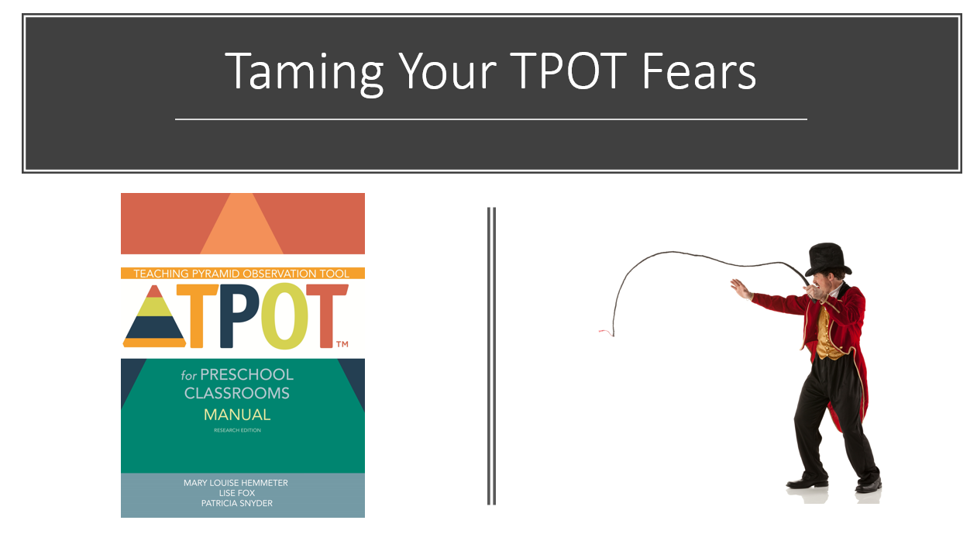
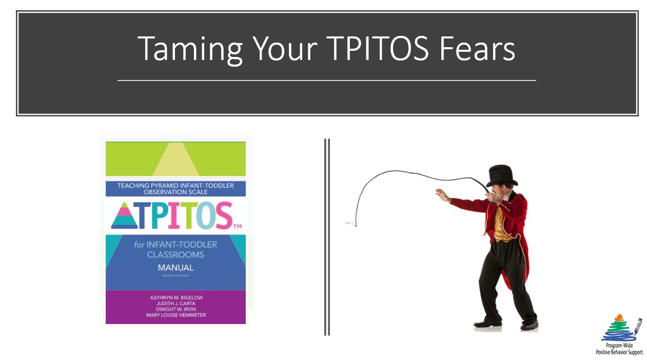
TPOT & TPITOS TIP TUESDA
TPOT & TPITOS tip Tuesday
Introducing a scripted story for teachers
that will ease their fears of the TPOT or TPITOS.

Slide 2
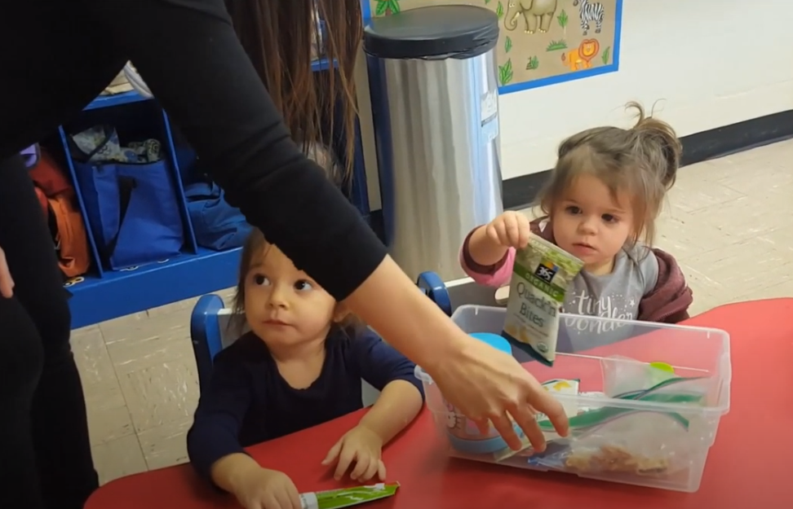

TPITOS TIP TUESDAY
Tpitos tip Tuesday
https://www.youtube.com/watch?v=jZesd5Zg1co
Offer choices during snack to increase child engagement and communication.

Slide 3


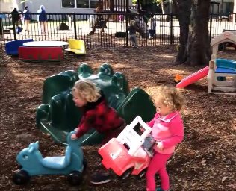
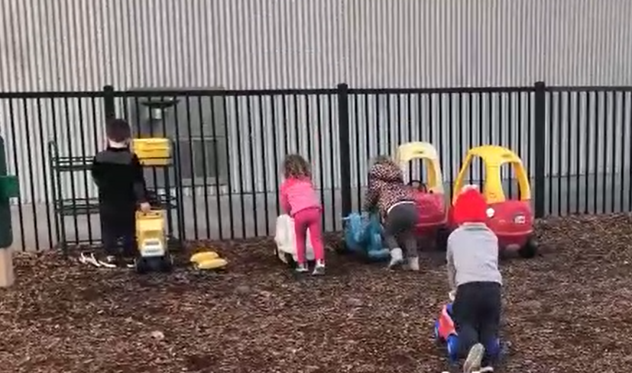
TIPTOS TIP TUESDAY
TPITOS Tip Tuesday
“Clean up time, clean up time.”
Providing toddlers with verbal and/or visual cues helps them transition smoothly
both inside and outside.
https://www.youtube.com/watch?v=qcHwDcuzj4M

Slide 4
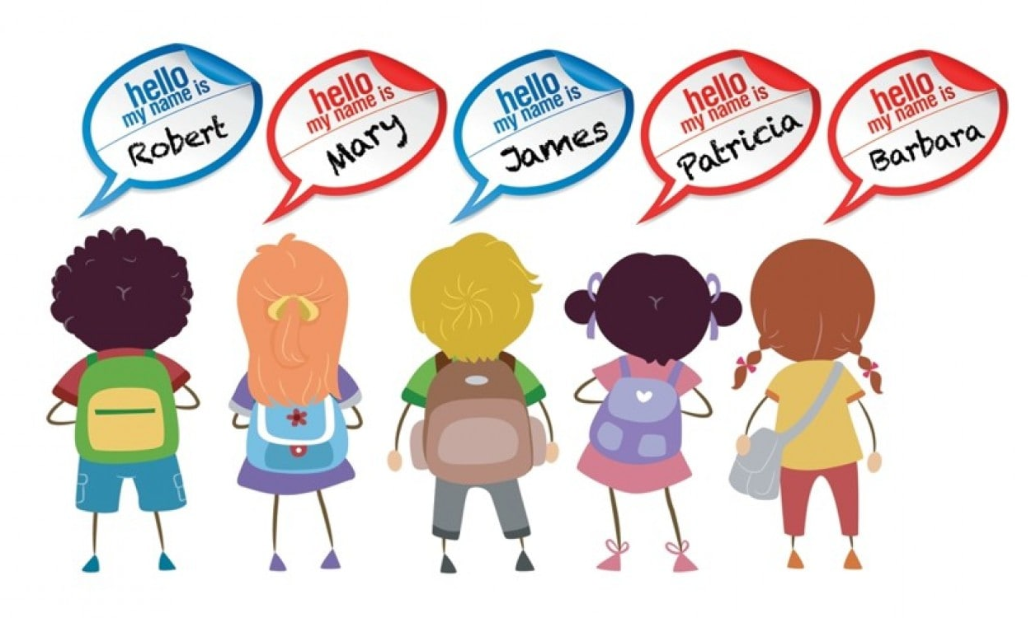


TIPTOS TIP TUESDAY
Tpitos tip Tuesday
https://www.youtube.com/watch?v=37Wnd0wHOes
When singing your children’s favorite songs at Circle Time, insert their names into verses of the songs to increase engagement.

Slide 5
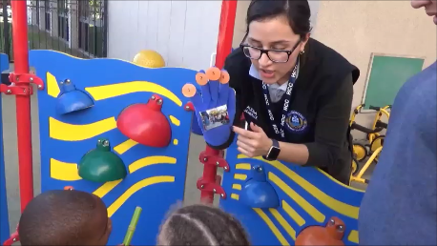
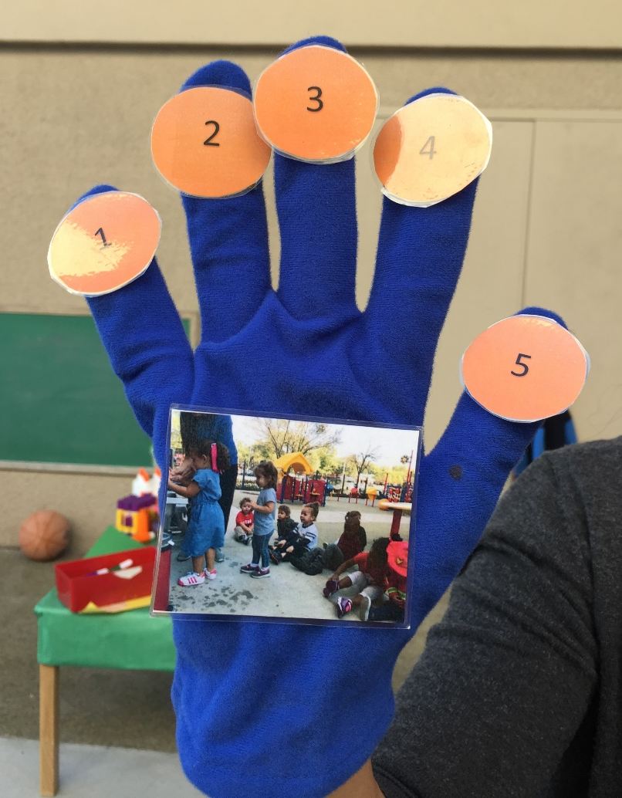
TIPTOS TIP TUESDAY
Tpitos tip Tuesday
https://www.youtube.com/watch?v=9QLHDOkidl4
Visual cues like this 5-Minute Glove can help children prepare for transitioning to a new activity.

Slide 6
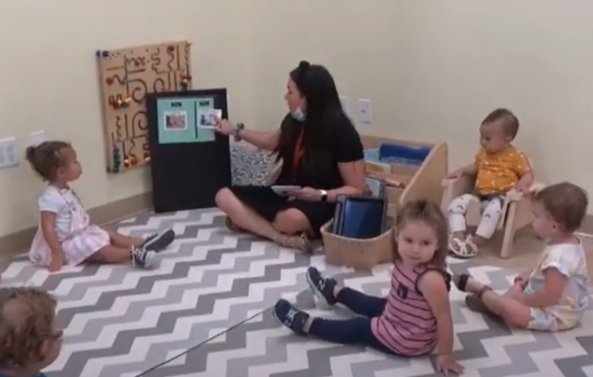
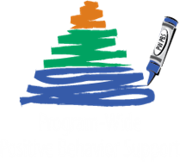
TIPTOS TIP TUESDAY
Tpitos tip Tuesday
https://www.youtube.com/watch?v=pJbiSb-v8e0
Reviewing the daily schedule and rules provides predictability to toddlers about what is expected.

Slide 7
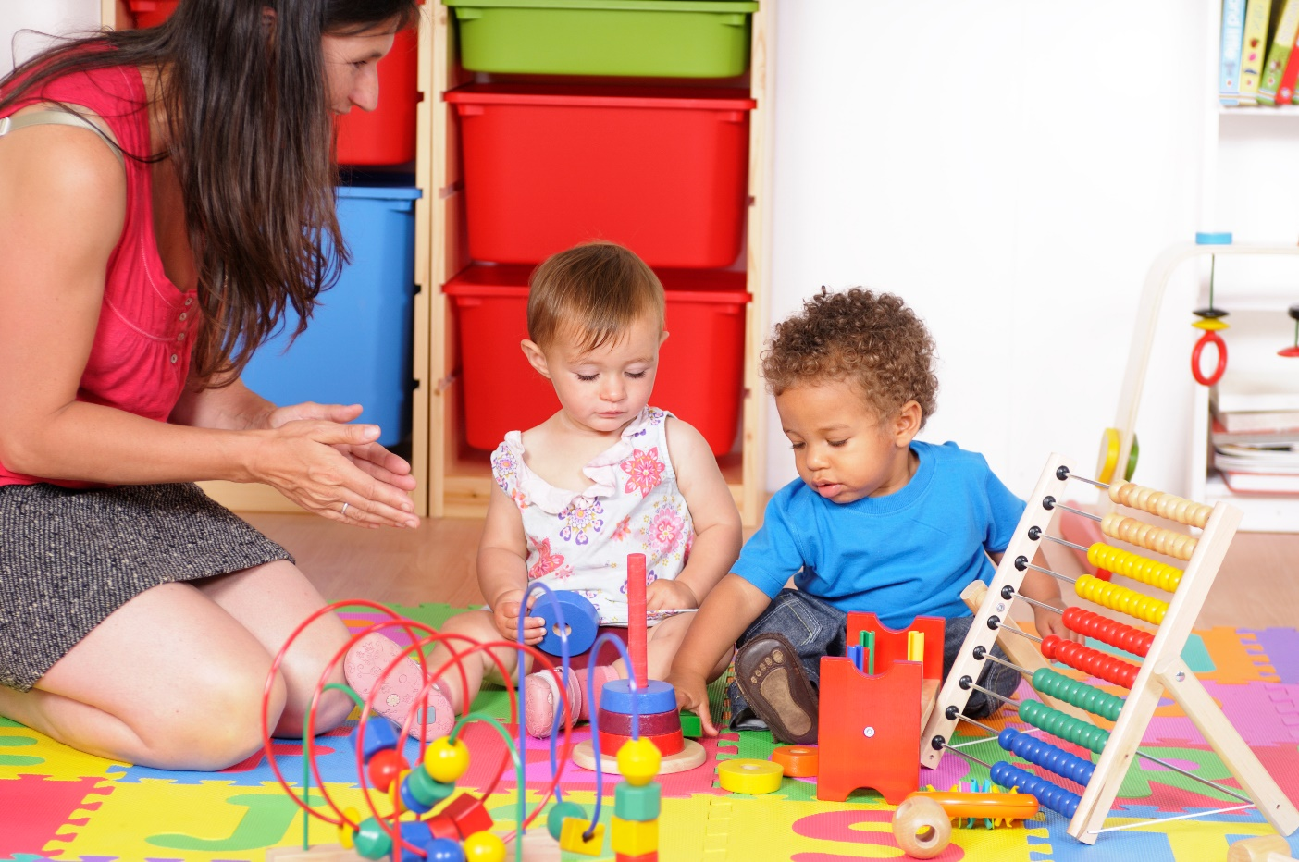
TIPTOS TIP TUESDAY
TPITOS Tip Tuesday
https://www.youtube.com/watch?v=E0MgmqnRiVM&list=PLaXAdXonRX0QXCCFd2yIWav4JXYBIm5U_&index=68&t=16s
Remaining nearby during children’s social interactions
helps build social and emotional skills.

Slide 8
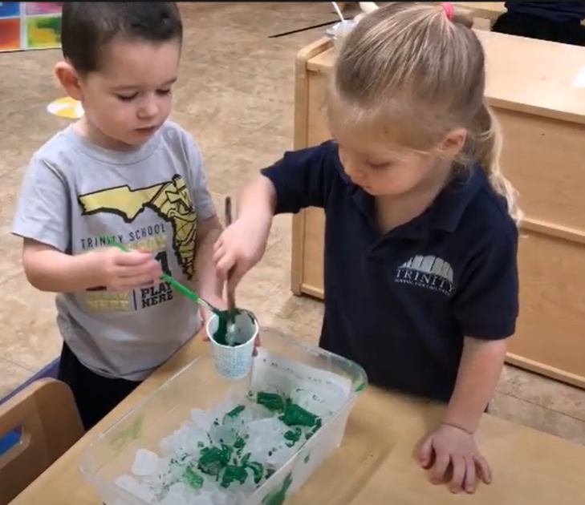
TIPTOS TIP TUESDAY
TPITOS Tip Tuesday
https://www.youtube.com/watch?v=qaxyJagY8fY
Helping toddlers work cooperatively is a great way
to promote positive peer interactions.

Slide 9
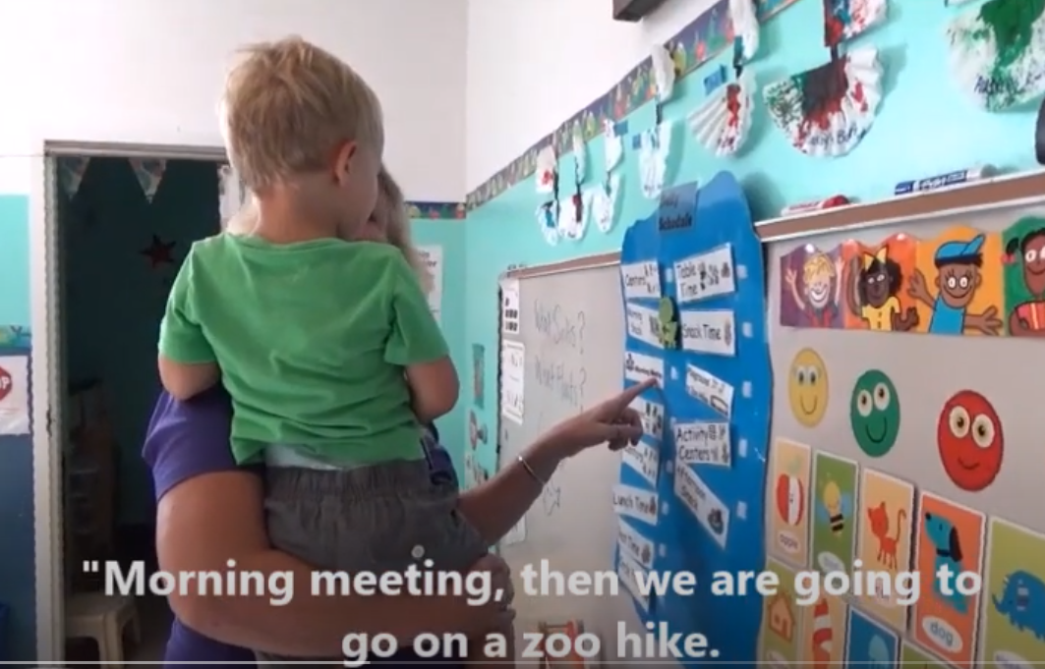
TIPTOS TIP TUESDAY
Tpitos tip Tuesday
https://www.youtube.com/watch?v=QoeqewQY-Ak
Reviewing the class schedule with a child is a fantastic way to provide individualized support during transitions.

Slide 10
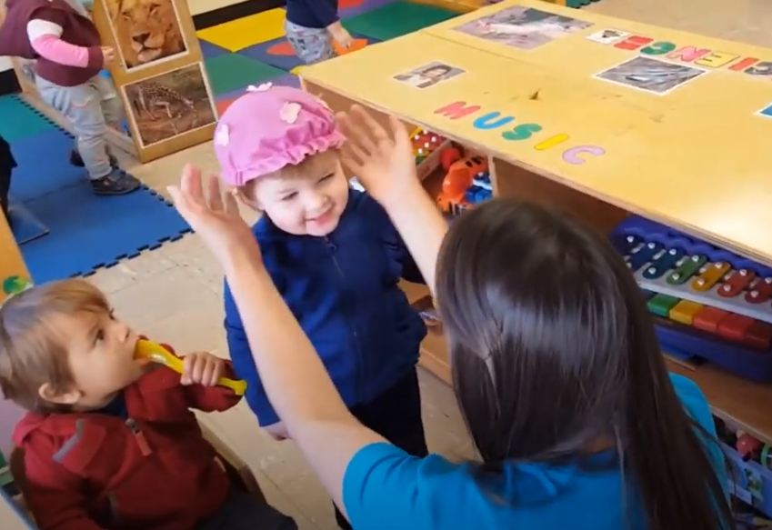
TIPTOS TIP TUESDAY
Tpitos tip Tuesday
https://www.youtube.com/watch?v=cIpZ1cRoWxc
Supportive conversations during play nurtures your relationships with children as well as their development.

Slide 11
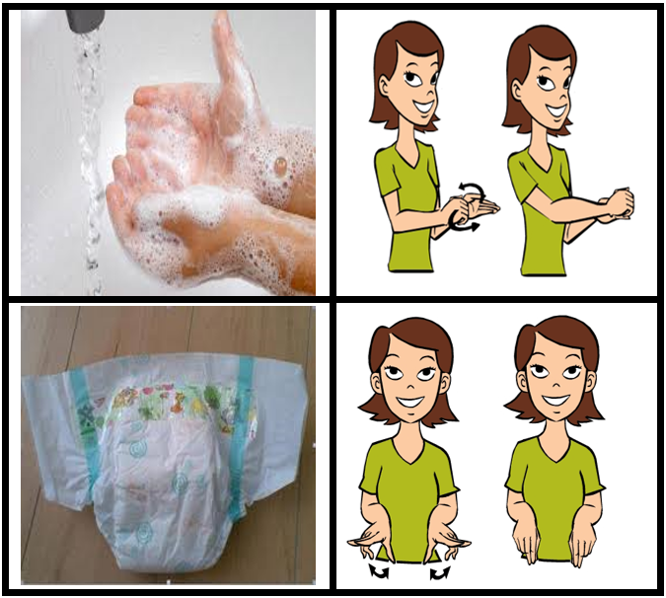


TIPTOS TIP TUESDAY
Tpitos tip Tuesday
https://www.youtube.com/watch?v=upfIgj1YfUA
Giving a child an individualized cue like a picture of a diaper or holding up & showing them a diaper can be helpful during transitions.

Slide 12
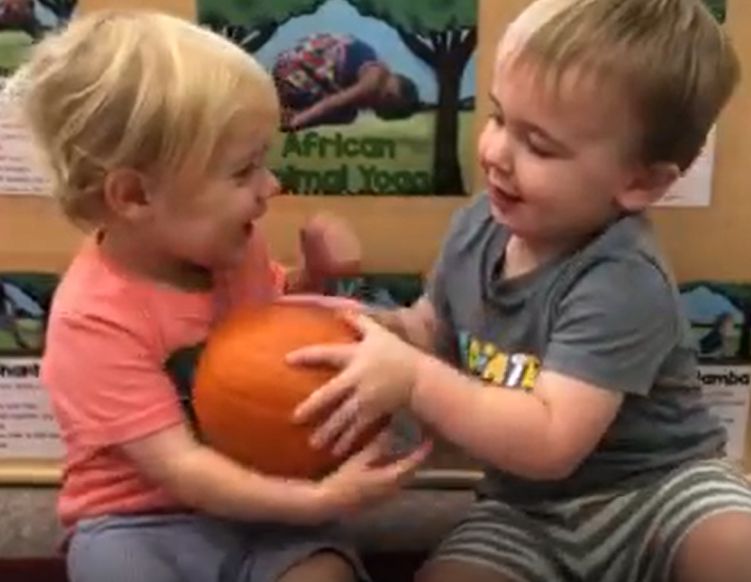

TIPTOS TIP TUESDAY
Tpitos tip Tuesday
https://www.youtube.com/watch?v=S1iwb7GyqBM
It’s fun to ‘Pass the Pumpkin’
at Circle Time.

Slide 13
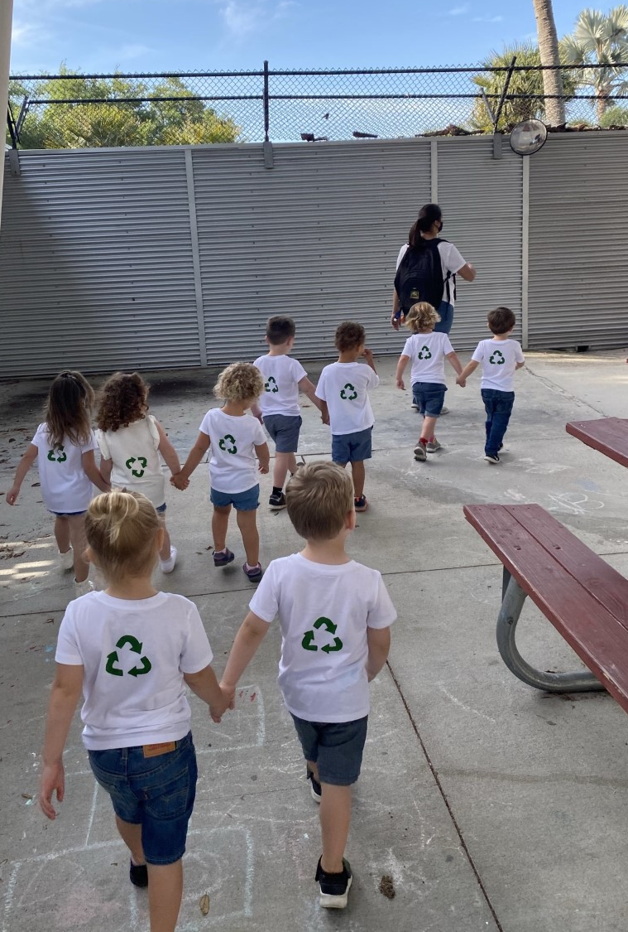


TIPTOS TIP TUESDAY
TPITOS Tip Tuesday
https://www.youtube.com/watch?v=PVuT2pzIFkQ
Walking in pairs is a great way to transition and build friendship skills.

Slide 14
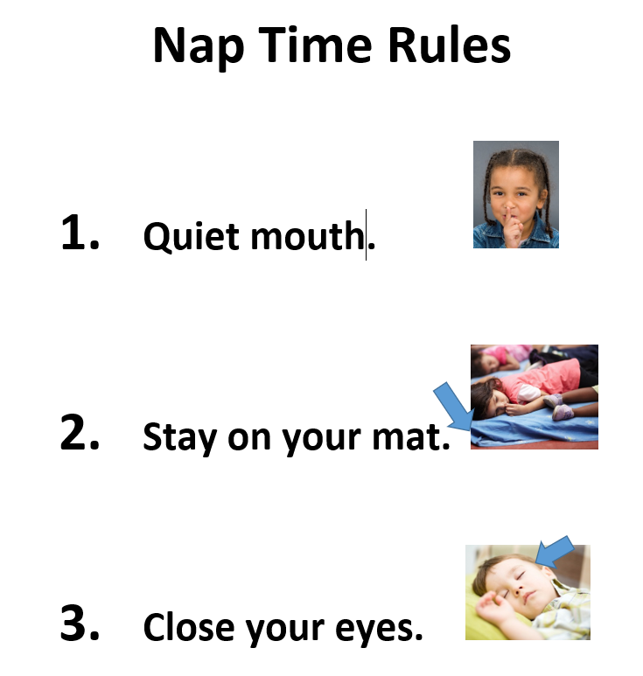


TIPTOS TIP TUESDAY
Tpitos tip Tuesday
https://www.youtube.com/watch?v=CmHAQW8BuHY
Nap Time Rules help children know what is expected at nap time.

Slide 15
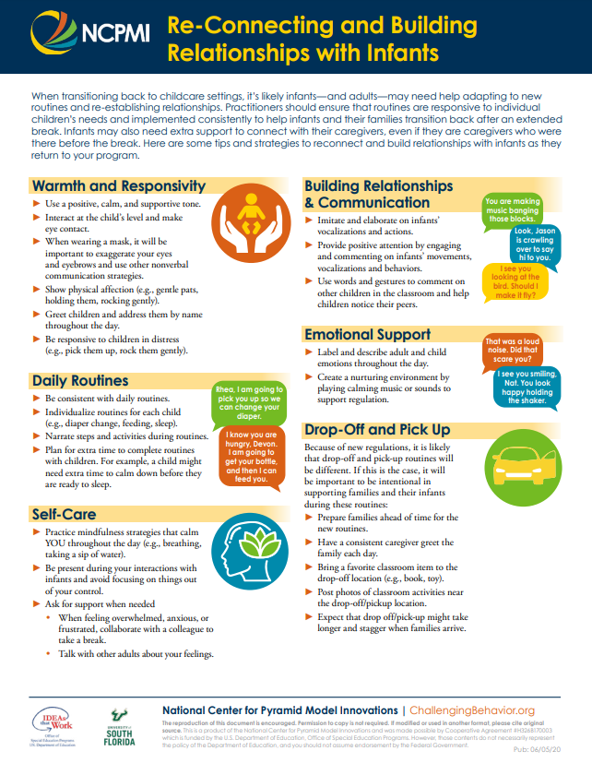
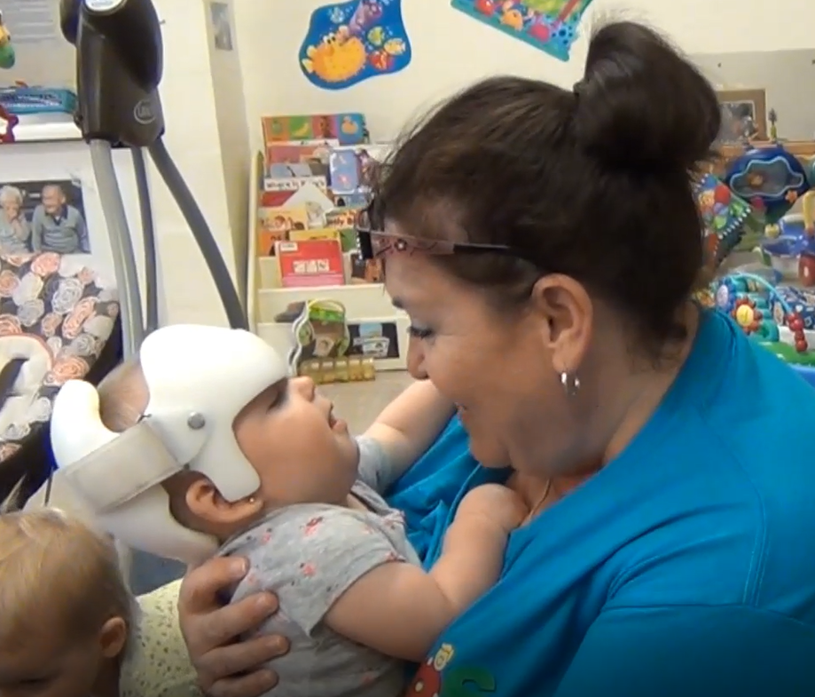
TIPTOS TIP TUESDAY
Tpitos tip Tuesday
https://www.youtube.com/watch?v=xq1kUsOvY2A

Slide 16
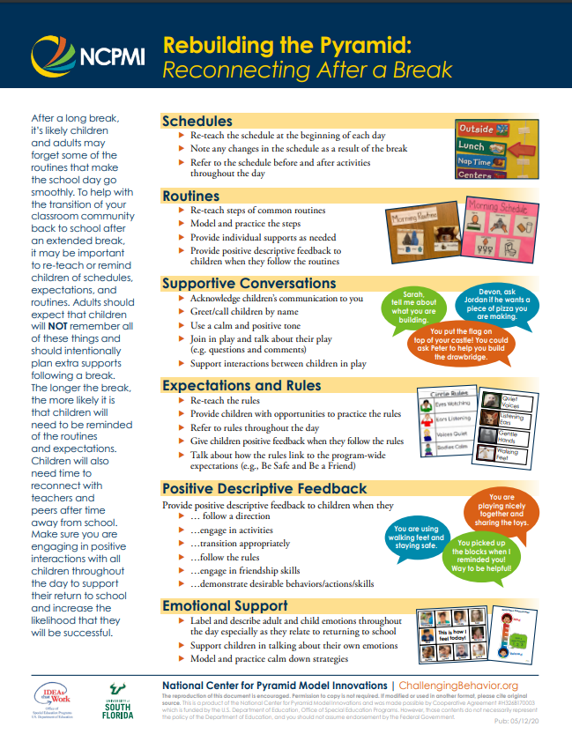
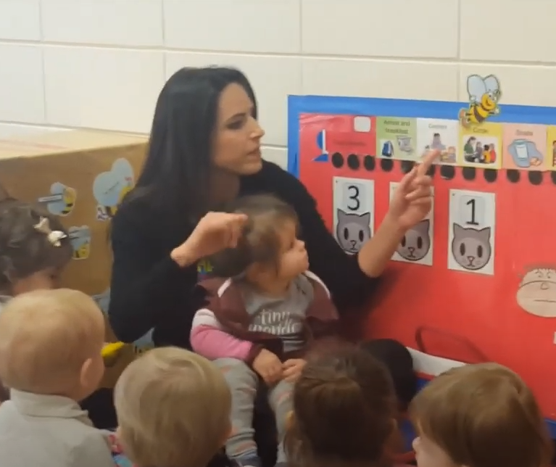
TIPTOS TIP TUESDAY
Tpitos tip Tuesday
https://www.youtube.com/watch?v=b1BgF3DP_l8
Reviewing the schedule throughout the day helps young children know what to expect.

Slide 17


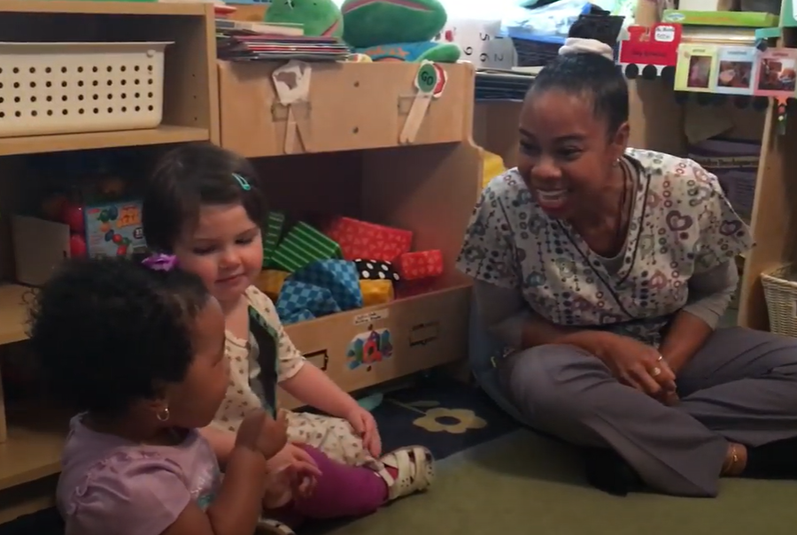
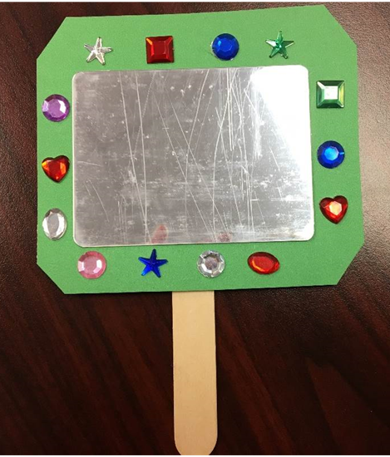
TIPTOS TIP TUESDAY
Tpitos tip Tuesday
https://www.youtube.com/watch?v=nXAND3HMJzE
Using a mirror to identify feelings
is fun and engaging!

Slide 18

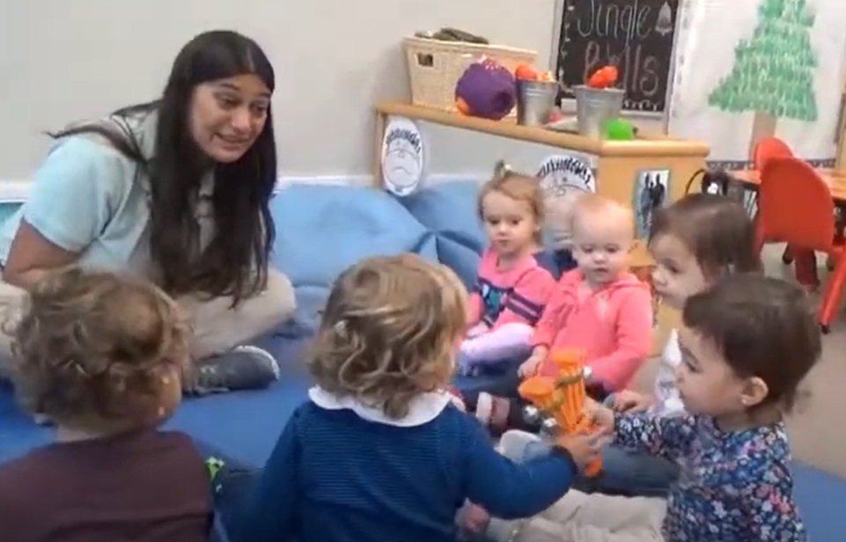
TIPTOS TIP TUESDAY
Tpitos tip Tuesday
https://www.youtube.com/watch?v=0xAtdvMjs1U&list=PLaXAdXonRX0QXCCFd2yIWav4JXYBIm5U_&index=63
Circle time is an ideal time to sing and practice sharing. Watch how these toddler teachers encourage children to share bells as they sing.

Slide 19
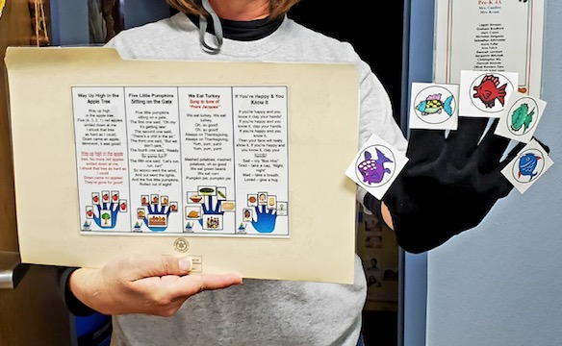
TIPTOS TIP TUESDAY
Tpitos tip Tuesday
https://www.youtube.com/watch?v=9emPeyq9xlc
Using a song glove is an engaging way to connect with children during Circle Time or while waiting for another activity or routine to start.

Slide 20
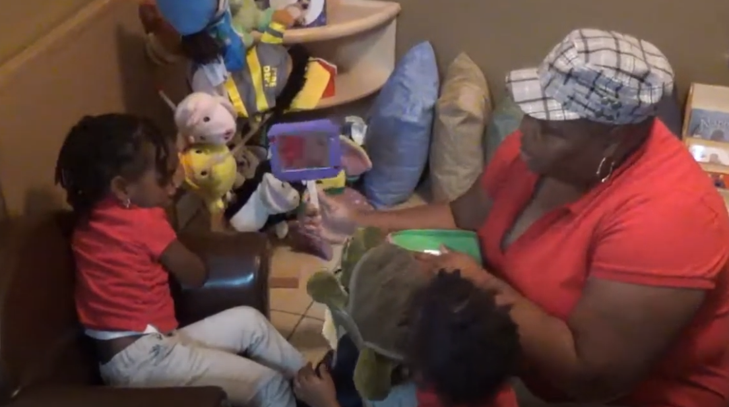
TIPTOS TIP TUESDAY
Tpitos tip Tuesday
https://www.youtube.com/watch?v=n3febfAfswI&list=PLaXAdXonRX0Q0GvwSsfRQ9lnMn6rXNRJS&index=10
It is essential for a teacher to remain calm, supportive, and positive when a child is experiencing a challenging situation.

Slide 21
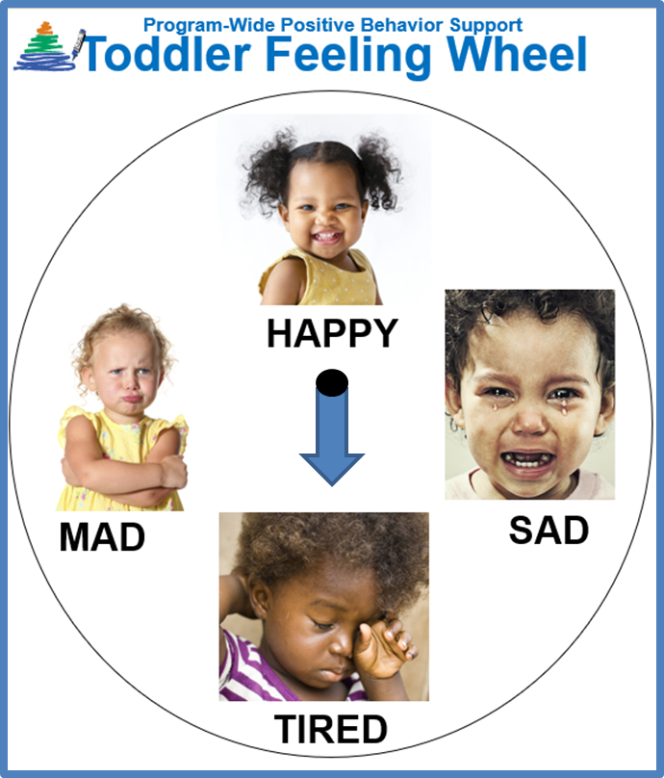
TIPTOS TIP TUESDAY
Tpitos tip Tuesday
https://www.youtube.com/watch?v=_PUueaXhqKA
Allowing toddlers to identify how they are feeling is an awesome way to enhance emotional vocabulary!

Slide 22
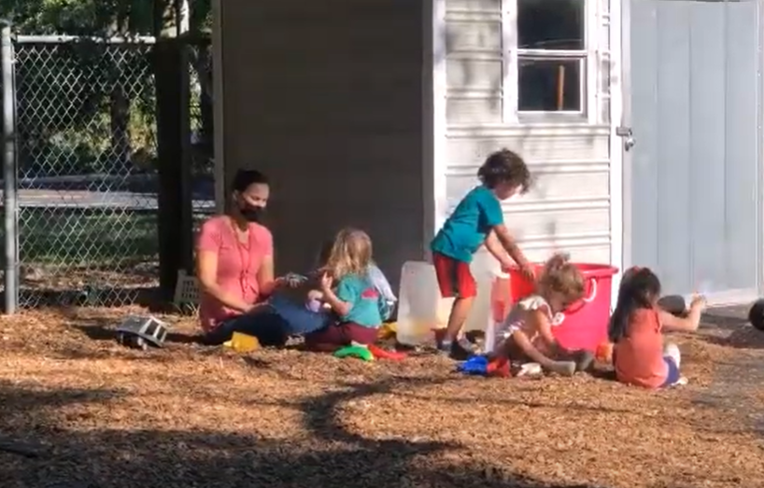


TIPTOS TIP TUESDAY
Tpitos tip Tuesday
https://www.youtube.com/watch?v=SsZ6mB_wVDk
Outside time is an opportune time for teachers to join in play with children and follow their lead.

Slide 23
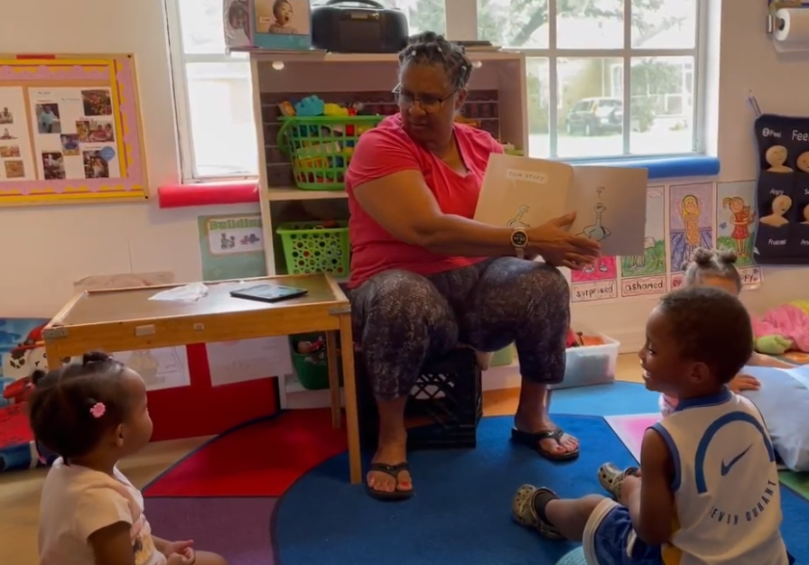

TIPTOS TIP TUESDAY
Tpitos tip Tuesday
https://www.youtube.com/watch?v=ogCdG_1fnww
Reading a story that allows for active participation is a great way to keep children engaged at Circle Time.

Slide 24
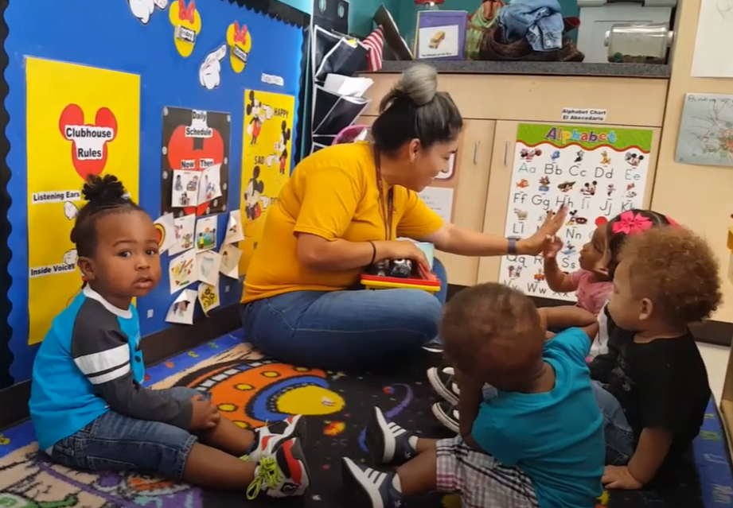

TPITOS Tip Tuesday
https://www.youtube.com/watch?v=xjbEwNG1J58&list=PLaXAdXonRX0QXCCFd2yIWav4JXYBIm5U_&index=9
Circle Time is a great opportunity to let toddlers know, in a positive tone, what they should do.

