Slide 1

Dr. Rosemarie Allen
Institute for Racial Equity & Excellence
Metropolitan State University of Denver
Early Childhood Suspensions: This is What We Know.

Slide 2
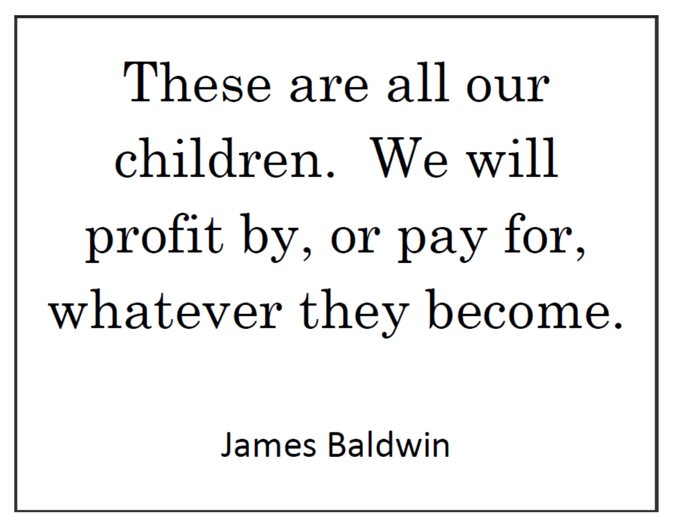

Slide 3

Suspension: a “disciplinary action that is administered as a consequence of a student’s inappropriate behavior, requires that a student absent him/herself from the classroom or from the school for a specified period of time” (Morrison and Skiba,
2001, p. 174).

Slide 4
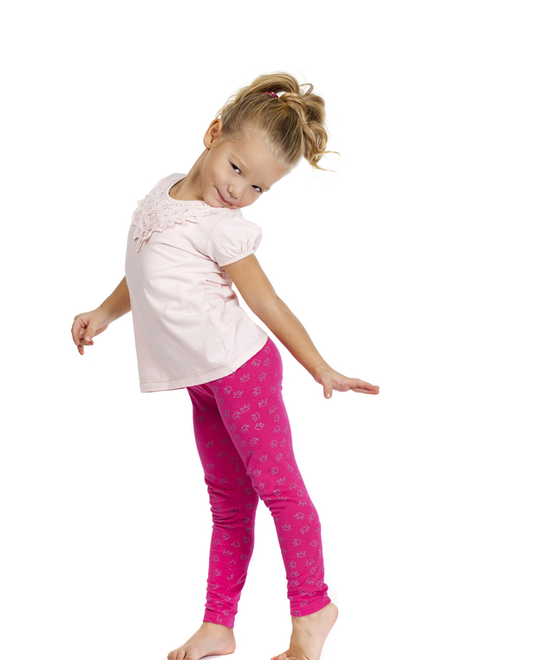
What is a suspension?
Excluding a child from the learning process; from the classroom: from the school premises

Slide 5
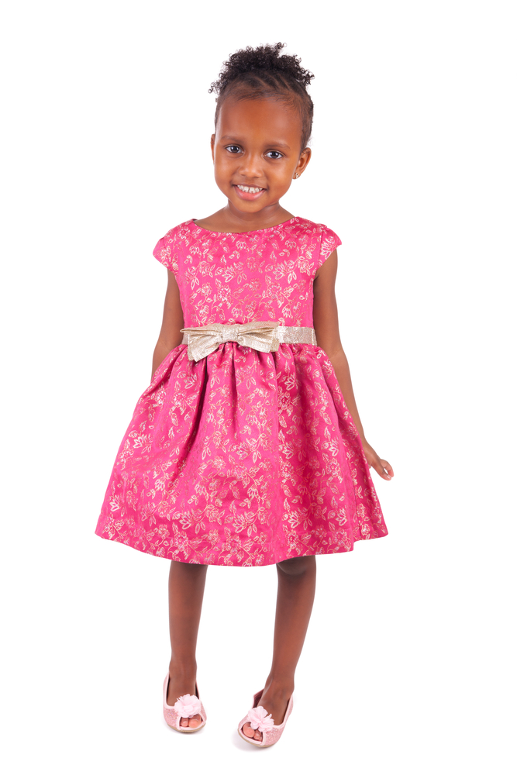
Child is sent home early
Child is placed on a modified schedule
Child is asked to leave the school/program because they are not a “good fit”
Child is left in the hallway or Director/Principal’s office for an extended period of time.

Slide 6

The 2014 OCR Data Showed:
5,000 preschoolers were suspended at least once and nearly 2,500 were suspended a second time.
Notes:
Talk about Raphael, TeyVon and Kim’s son. Also talk about language differences.
Ask participants to share “Single Stories” they may have or that others may have had of them.

Slide 7

The New OCR (2016)
Patterns of racial and gender disproportionality:
Boys represent 54% of the preschool population but 78% of those suspended.

Slide 8

The New OCR (2016)
Patterns of racial and gender disproportionality:
African American preschoolers are 3.6 times more likely to be suspended than their White peers.

Slide 9

The New OCR (2016)
African American girls are 20% of preschool female population but 54% of girls suspended from preschool
(United States Department of Education, 2016)

Slide 10

State Suspension Studies

Slide 11
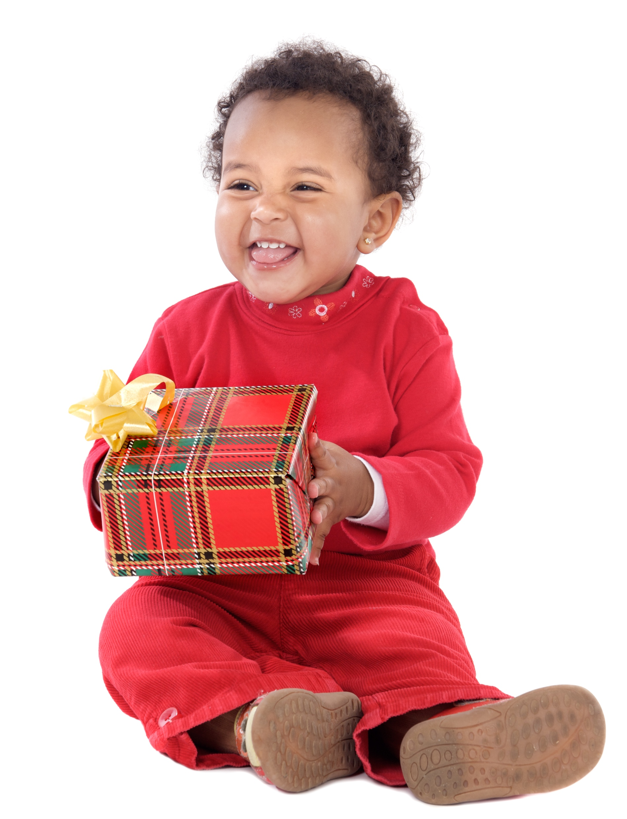
A survey conducted in Illinois reported that more than 40 percent of the State’s childcare programs had suspended infants and toddlers. Racial and gender demographics were not included in this study (Cutler & Gilkerson, 2002).

Slide 12
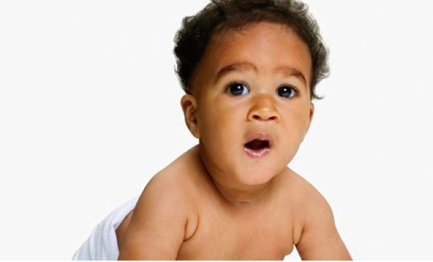
In North Dakota, 20% of ECE programs expelled children. Of those expelled, 53% were infants and toddlers and 31% were preschool children. (North Dakota State Data Center, 2008).

Slide 13

In Michigan, the expulsion rate for preschoolers was 27 per 1000 students,
That was 34 times the state’s kindergarten through 12th grade rate. (Martin, Bosk & Bailey, n.d.).

Slide 14
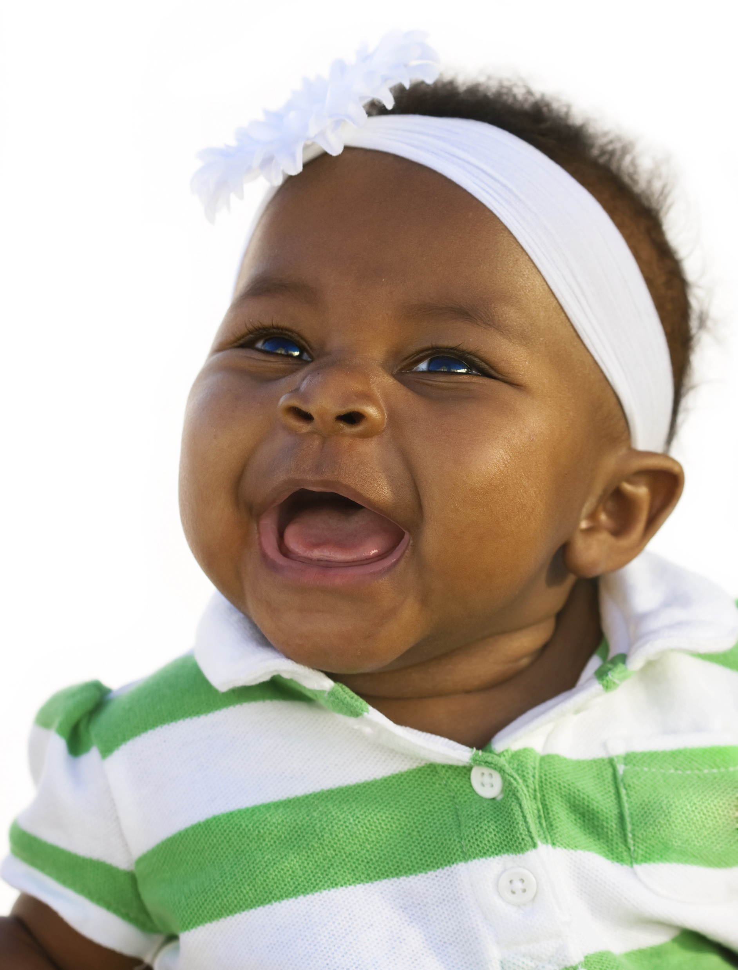
Racial Disproportionality in Suspensions

Slide 15

Disproportionality may occur in situations other than suspensions:
Classroom discipline
Referrals to the Director/Principal
Sending a child home early
Sending a child to another classroom
Corporal Punishment

Slide 16

Why Does This Happen??
Notes:
Pause.
Give people a chance to respond.
If there are no responses, use this slide as a transition and move to the next.

Slide 17
Implicit Bias in Early Childhood Education Decision Making
Kent McIntosh
University of Oregon

Slide 18
What is implicit bias?
Unconscious, automatic
  Generally not an indication of our beliefs and values
  We all have it (even those affected by it)
Based on stereotypes
More likely to influence:
  Snap decisions
  Decisions that are ambiguous
Notes:
MOST PREVALENT IB: Age

Slide 19
A Multidimensional View of Bias
Racial Bias
Disproportionate Discipline
Situation
Vulnerable Decision Points
Subjective Behavior Unfamiliar with Student
Vague Discipline System Hunger
Classrooms Fatigue
(Smolkowski et al., 2016)
Notes:
no change to his or her attitudes or beliefs, an individual may selectively show racial bias in different decision situations. For example, a teacher may make more equitable discipline decisions at the start of the day but be more likely to send students of color to the office at the end of the day
More accurate predictor of biased decision making AND

Slide 20
Neutralizing Routines for Reducing Effects of Implicit Bias
Self-assessment
“Is this a vulnerable decision point?”
Setting event
Antecedent
Behavior
Consequence
Child is new to program
Fatigue
Not following directions after requests (subjective behavior)
Remove child from setting
Child leaves setting (Escape social interaction)
Alternative Response
Take 3 deep breaths and reteach
Notes:
This is ME (my routine)
“You can’t punish skills into a child”

Slide 21
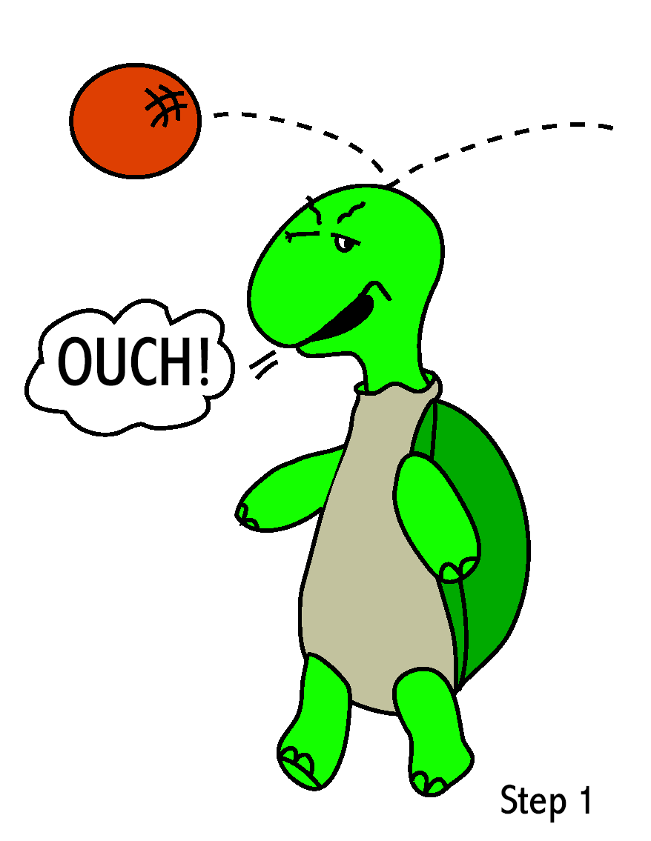
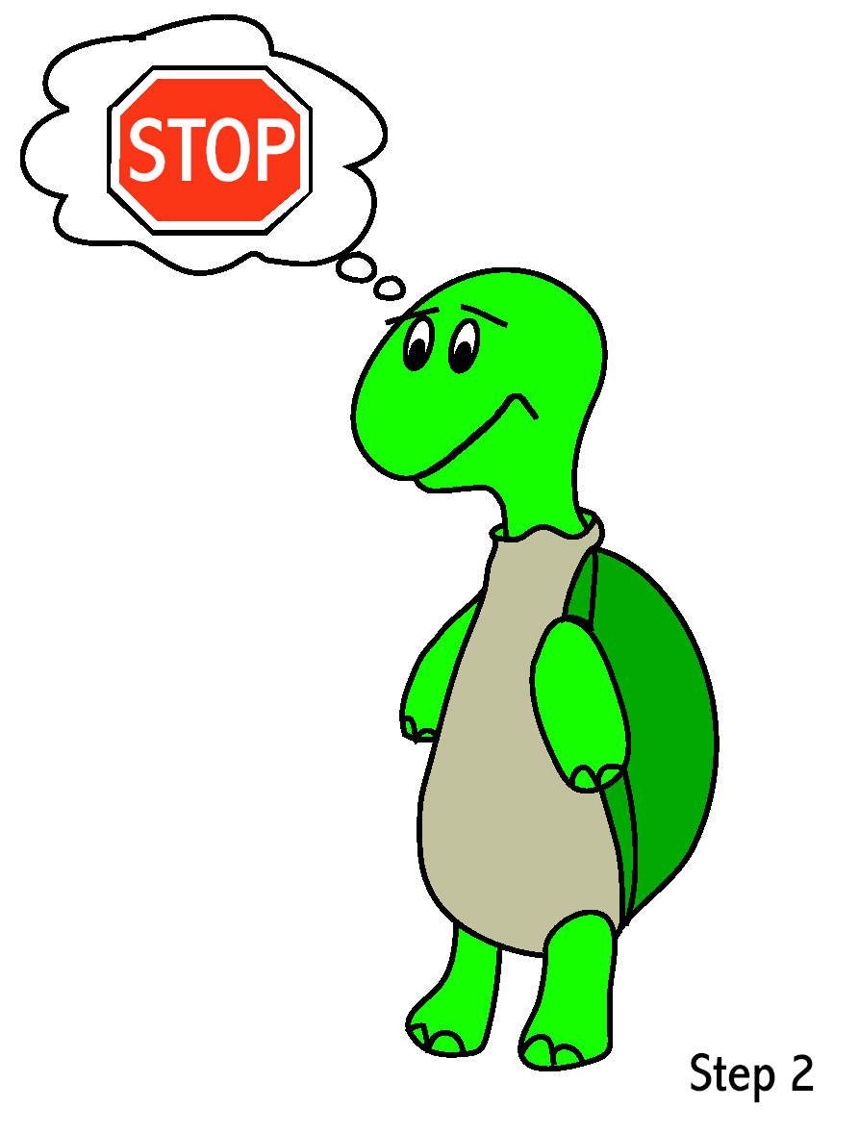
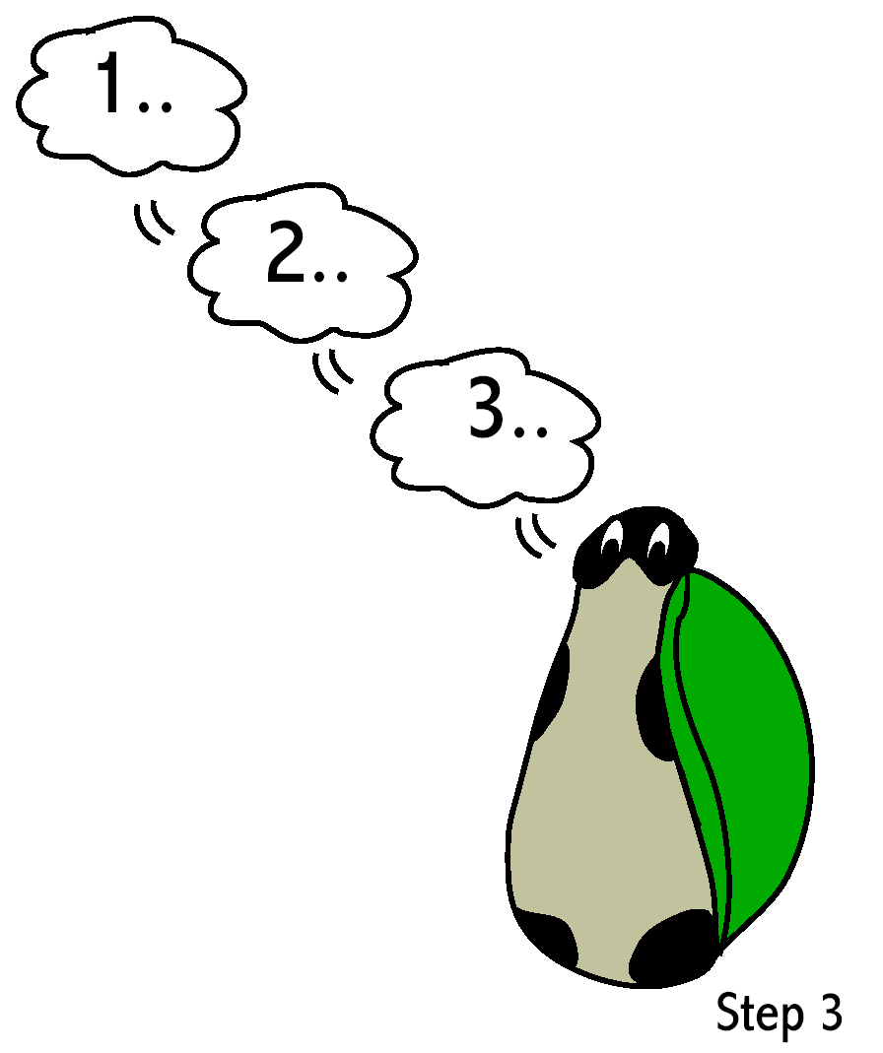
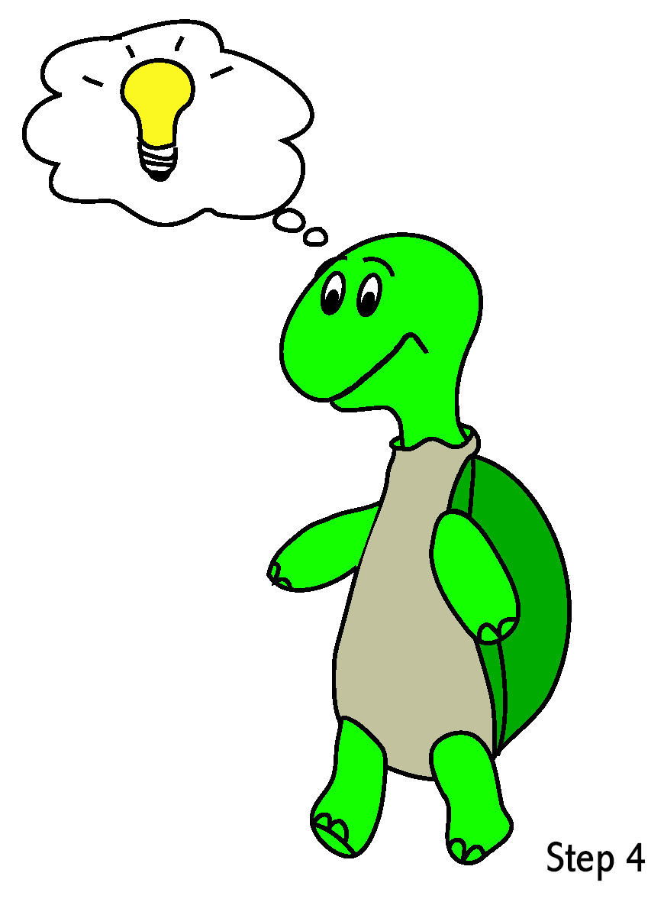
Turtle Technique
Recognize
that you
feel angry.
“Think”
Stop.
Go into shell. Take 3 deep breaths. And think calm, coping thoughts.
Come out of shell when calm and thinking of a solution.

Slide 22



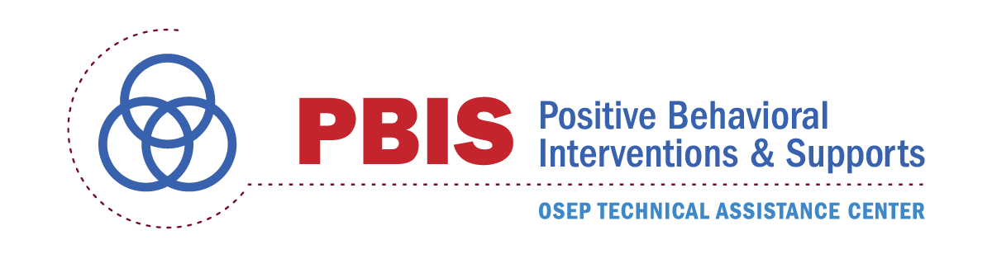
Contact Information
Kent McIntosh
  Special Education Program
  University of Oregon
  kentm@uoregon.edu
  @_kentmc
Cannon Beach, Oregon
© GoPictures, 2010
Handouts: http://kentmcintosh.wordpress.com

Slide 23
We Are Asking The Wrong Question
It is not - Why are children of African descent failing to thrive in the pre-k through third grade years?
The real question is “How does the system of early childhood education fail to fully develop many young children of African descent – particularly boys?
This is a question that must be answered with reference to the historical, the cultural, and the political as frames of reference for the promotion of effective educational strategies.

Slide 24
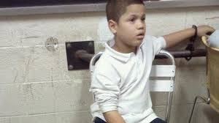
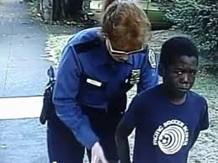
Current History?
Caucasian teachers have negative perceptions of the movement styles of Black males (Neal et al., 2003)
African American boys at greatest risk for socio-emotional problems (Barbarin and Soler, 1993)

Slide 25
From Boys to Men in the African American Community
“The litany of difficulties associated with African American boys developing into men is extensive; it has all the elements of a classic tragedy. African American boys are vulnerable to a range of social, emotional, and academic difficulties from birth through adulthood. Beginning early in life, substantial numbers of African American boys are bombarded with a range of individual, family, and community trauma that divert them onto a developmental trajectory that is filled with adverse academic and social outcomes. Glimmers of the imminent difficulties are easy to detect.”
Barbarin, O (2010) Halting African American Boys Progression From Pre-K to Prison: What Families Schools and Communities Can Do. American Journal of Orthopsychiatry, 80,1,81-88

Slide 26
Patterns of Achievement for Young African American Boys After the Transition to Kindergarten
Increasing Academically
Low Achiever – Declining Academically
Early Achiever – Declining Academically and Socially
Consistent Early Achiever
Iruka, I. U., Gardner-Neblett, N., Matthews, J. S., & Winn, D-M. C. (2014). Preschool to kindergarten transition patterns for African American boys. Early Childhood Research Quarterly, (29)2, 106-117.

Slide 27
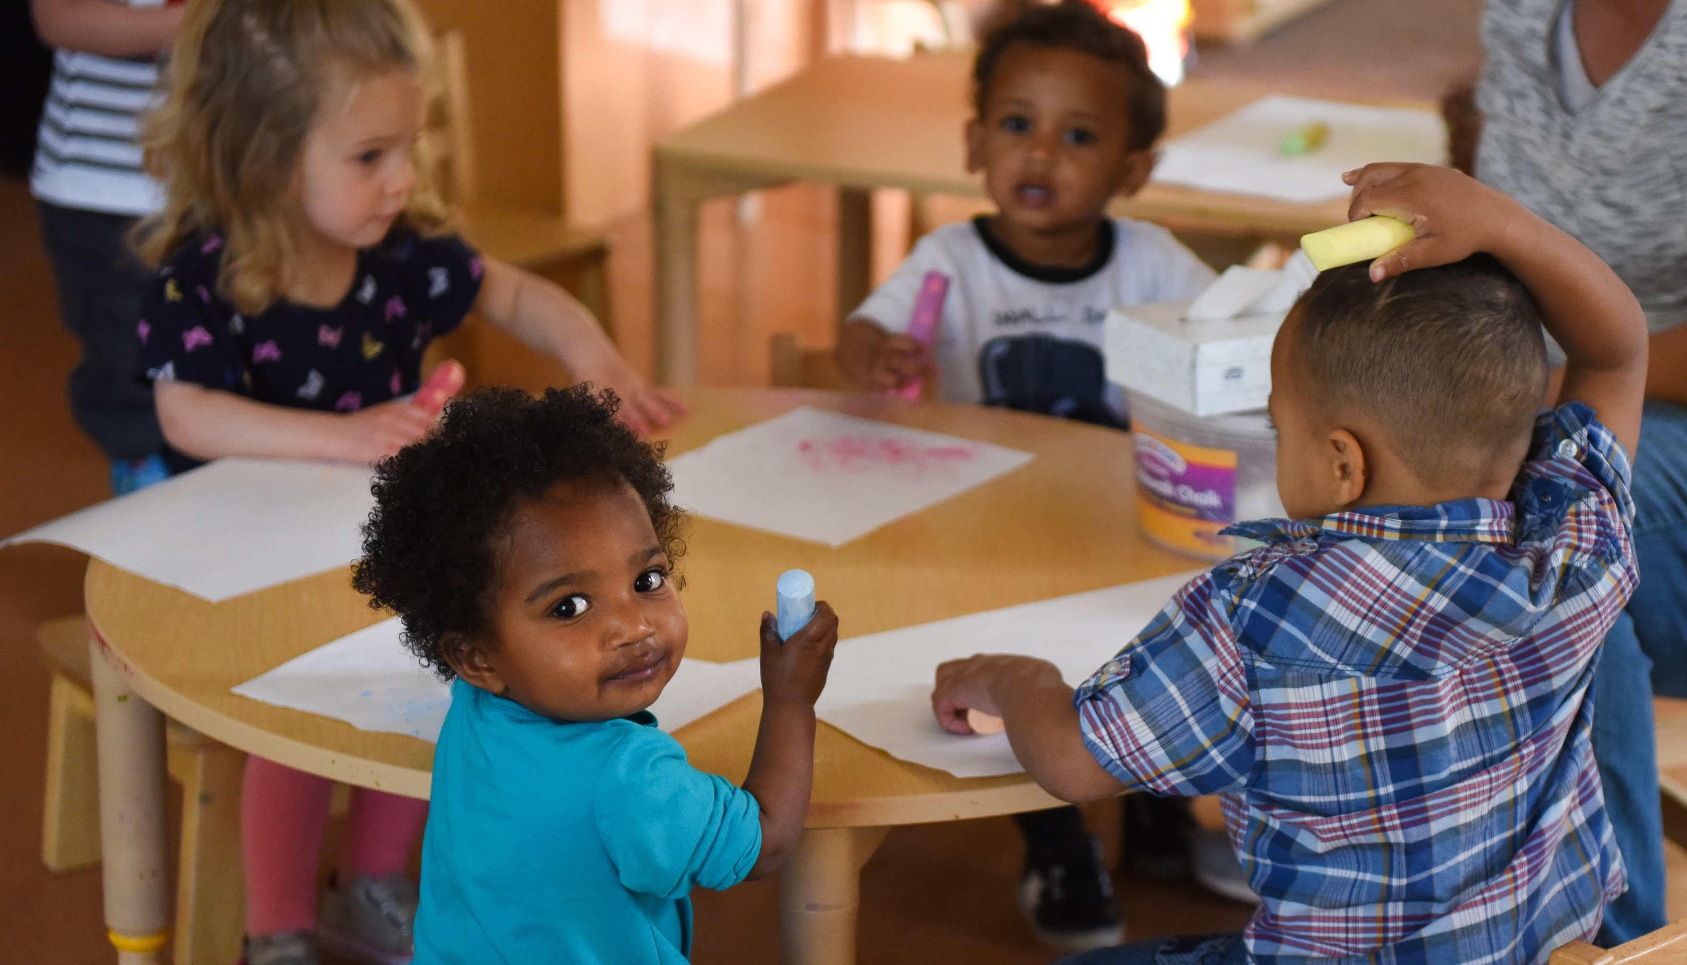
Public Policy Action to Reduce Early Suspensions & Expulsions
March 2018

Slide 28
Existing State Policies Regarding Early Suspensions & Expulsions
Restrictions on Exclusionary Discipline
Promoting Alternatives
New Jersey (S. 2081): Restrictions K-2nd Grade
Rhode Island (HB 7056): Superintendent review of unequal impact
Connecticut (SB 1053): Restrictions PreK-2nd Grade
Oregon (SB 553): Restrictions on OSS, PreK-5th Grade
California (A.B. 1014): Grants for alternative approaches
Utah (H.B. 460): Training program for restorative practices
Indiana (HB 1635): Grants for school climate
Louisiana (SB 130): Evaluation of positive behavioral interventions
Notes:
Source: https://www.ecs.org/wp-content/uploads/Suspension_and_Expulsion.pdf

Slide 29
State Policy Action – 2017: Restricting Suspension & Expulsion
18 States Proposed Legislation on Suspension & Expulsion (across the EC through 12 spectrum)
  5 States Enacted Legislation
34 total bills proposed
  9 Bills enacted
Maryland, Arkansas, and Texas: Focused on significantly restricting grounds for young children
Notes:
Source: https://www.ecs.org/wp-content/uploads/Suspension_and_Expulsion.pdf

Slide 30
State Policy Acion – 2017: Restricting Suspension & Expulsion
12 States & D.C. Proposed Legislation on Promoting Alternatives (across the EC through 12 spectrum)
  3 States Enacted Legislation
25 total bills proposed
  4 Bills enacted
Maryland, Virginia, and Colorado: Promoting alternatives or requiring analysis and sharing of best practices
Notes:
Source: https://www.ecs.org/wp-content/uploads/Suspension_and_Expulsion.pdf

Slide 31

Other Context for Policy Action
Federal Debate
  School Safety vs. Inclusive Practices
Local Action
  School Boards in large cities taking the lead (D.C., Denver, Houston)
State Policy
  2018 Session

Slide 32

Thank you
Bill Jaeger
Vice President, Early Childhood & Policy Initiatives
bill@coloradokids.org

Slide 33

You are a super-hero!
You get to touch the lives of this country’s youngest citizens
You can breathe life into a child.

Slide 34

Let’s Manage our own behavior, give kids the tools to regulate theirs and create a classroom of super heroes!

