Slide 1
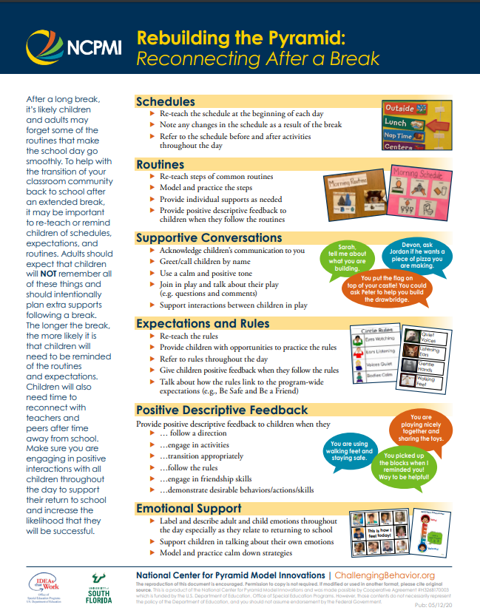
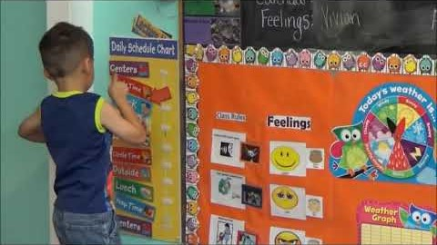



TPOT Tip Tuesday
https://www.youtube.com/watch?v=uLlNtnWPovg
Reviewing your schedule everyday is critical to providing predictability and assurance to young children during typical times and times that are more challenging, like returning after a break.

Slide 2
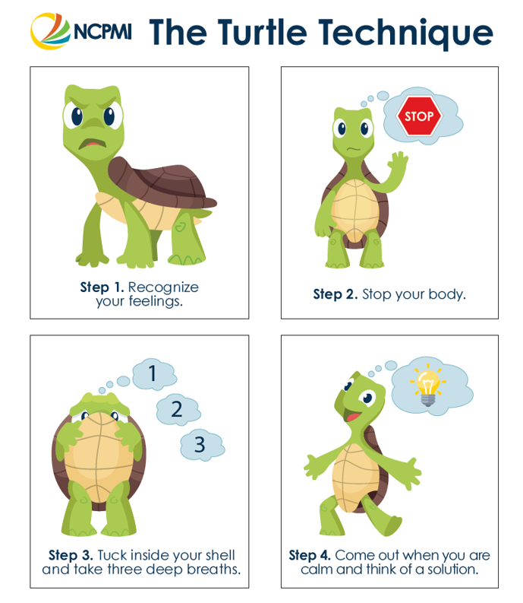
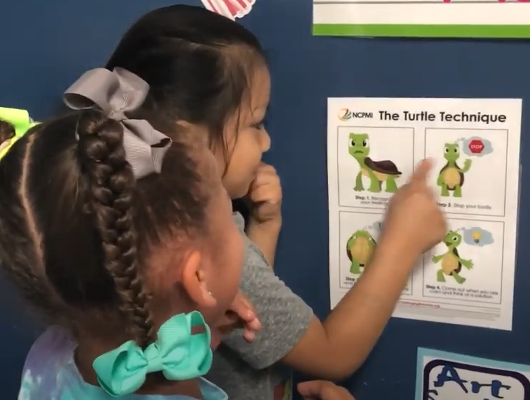
TPOT Tip Tuesday
Posting the visual steps to The Turtle Technique is a great way to encourage children to use breathing to calm their bodies.
https://www.youtube.com/watch?v=s1kYq7CkMd0&list=PLaXAdXonRX0T2JqbI6BcuRFHbQ_oR8DpD&index=15

Slide 3
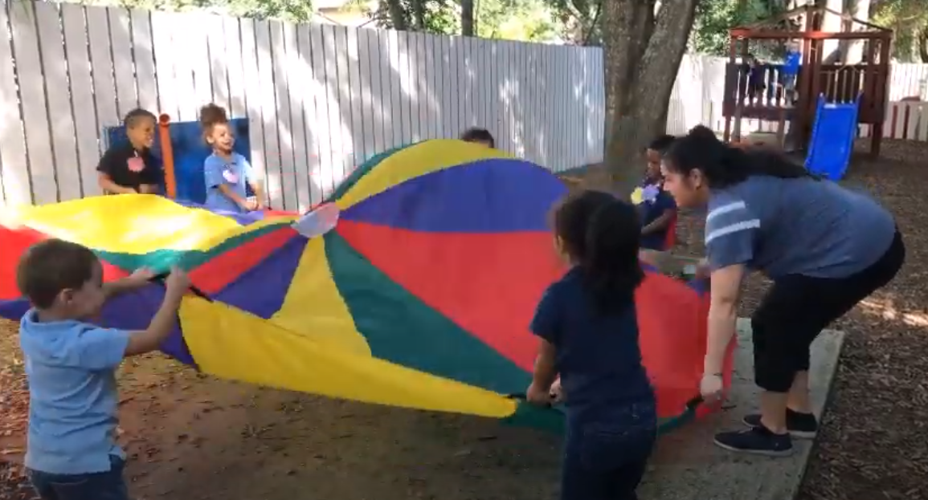
TPOT Tip Tuesday
https://www.youtube.com/watch?v=9vGTAePGuf0
Parachute play at Children’s Nest Town N’ Country

Slide 4
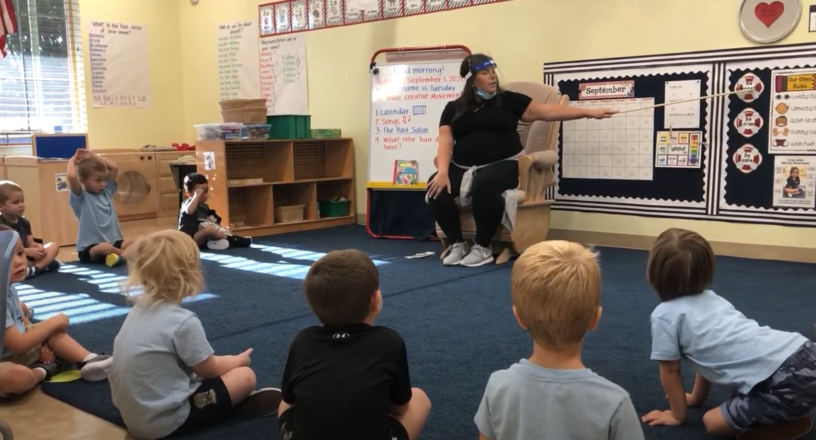
TPOT Tip Tuesday
https://www.youtube.com/watch?v=5cgg95BmFBY
Reviewing expectations and rules at circle time is a great way to start the day!

Slide 5
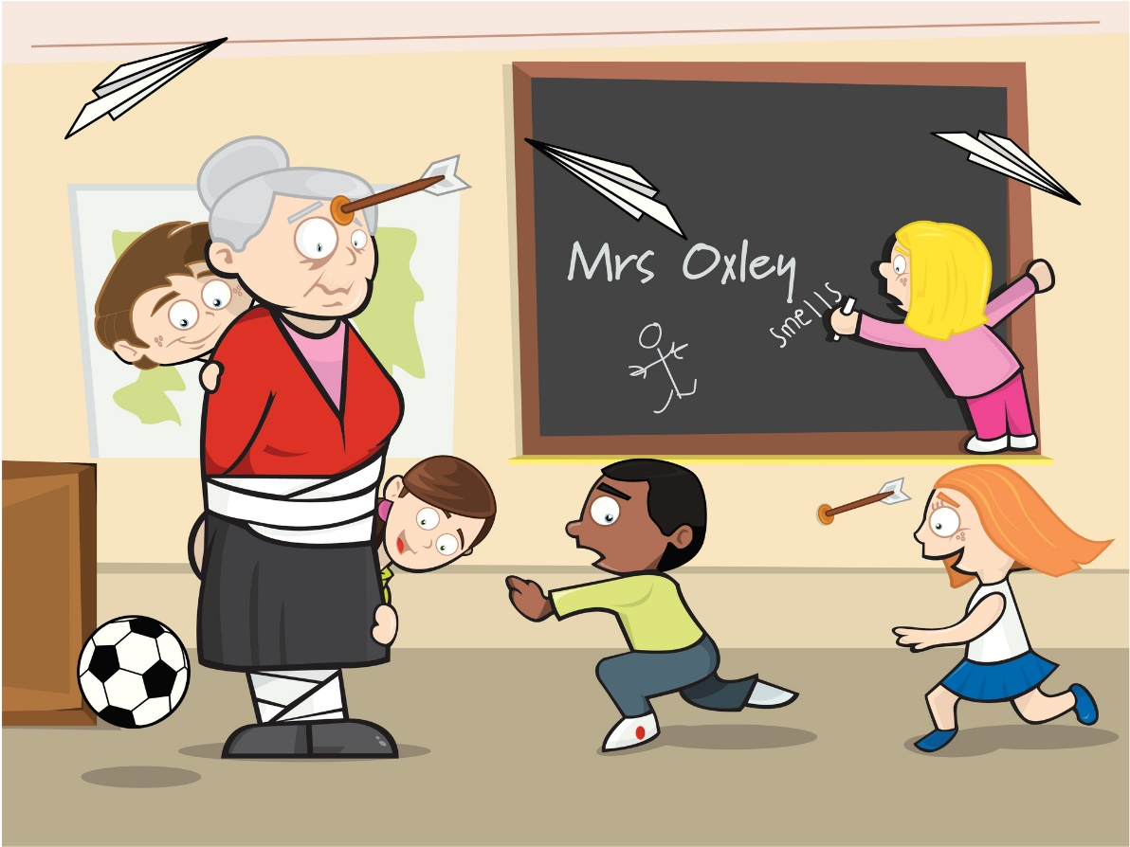
TPOT Tip Tuesday
Transitions don’t have to be tricky.
https://www.youtube.com/watch?v=HCu4nQXF4sk
Teaching children the steps AND expectations of transitions can make your transitions !
TERRIFIC

Slide 6
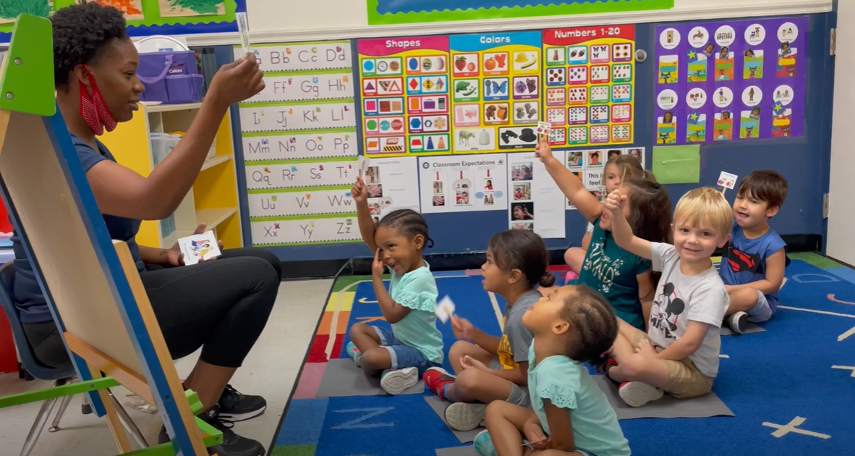
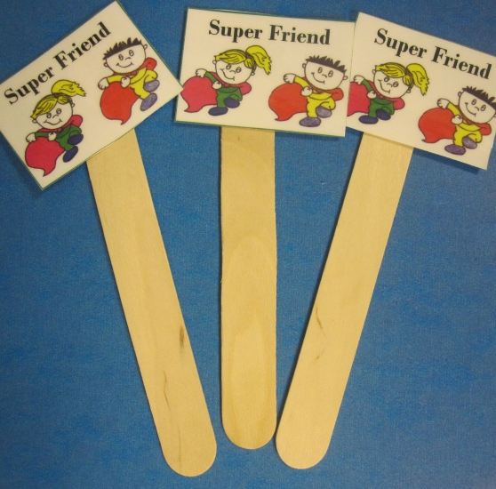
TPOT Tip Tuesday
Super Friend to the rescue!
https://www.youtube.com/watch?v=M03ehm8cmow
Playing a friendship game during circle time is a fantastic way to practice friendship skills.

Slide 7
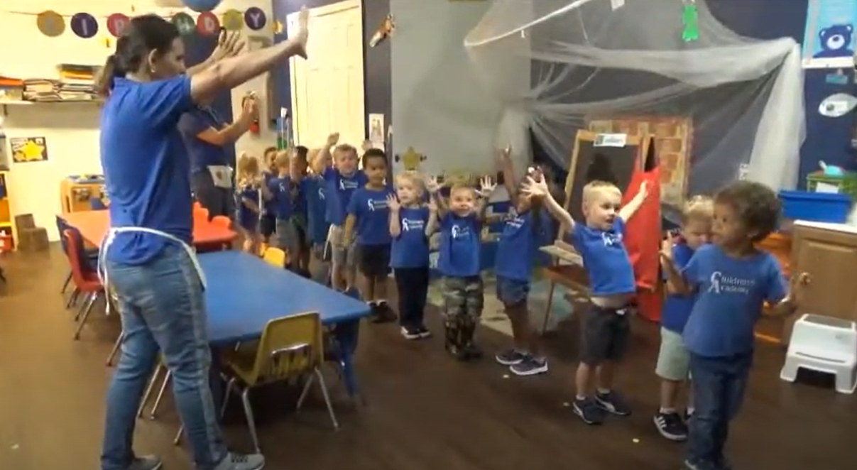
TPOT Tip Tuesday
https://www.youtube.com/watch?v=oXLqTinVNKQ
Chants and choices are a wonderful way to increase child engagement during transitions!

Slide 8
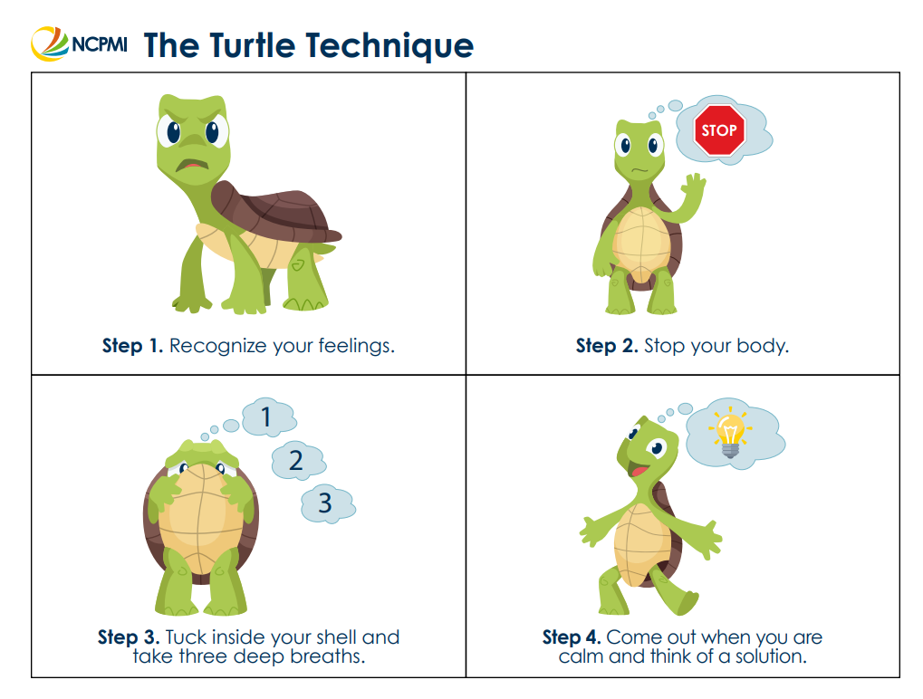


TPOT Tip Tuesday
https://www.youtube.com/watch?v=h2_HfMZx1-Q
Check out this adorable Tucker Turtle song to help children learn and practice the Tucker Turtle steps!

Slide 9
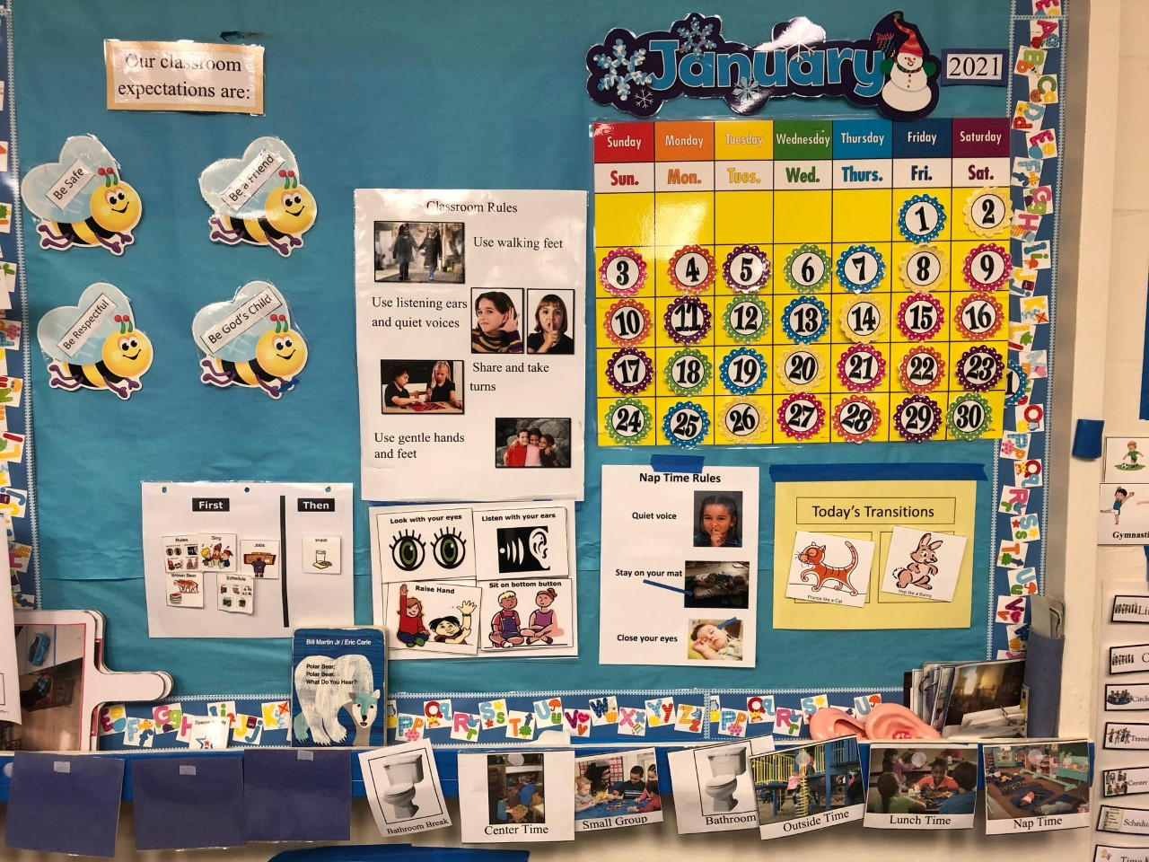
TPOT Tip Tuesday
https://www.youtube.com/watch?v=rSIiwReNJWc
Reviewing posted rules using a chant encourages children to be more actively engaged.

Slide 10

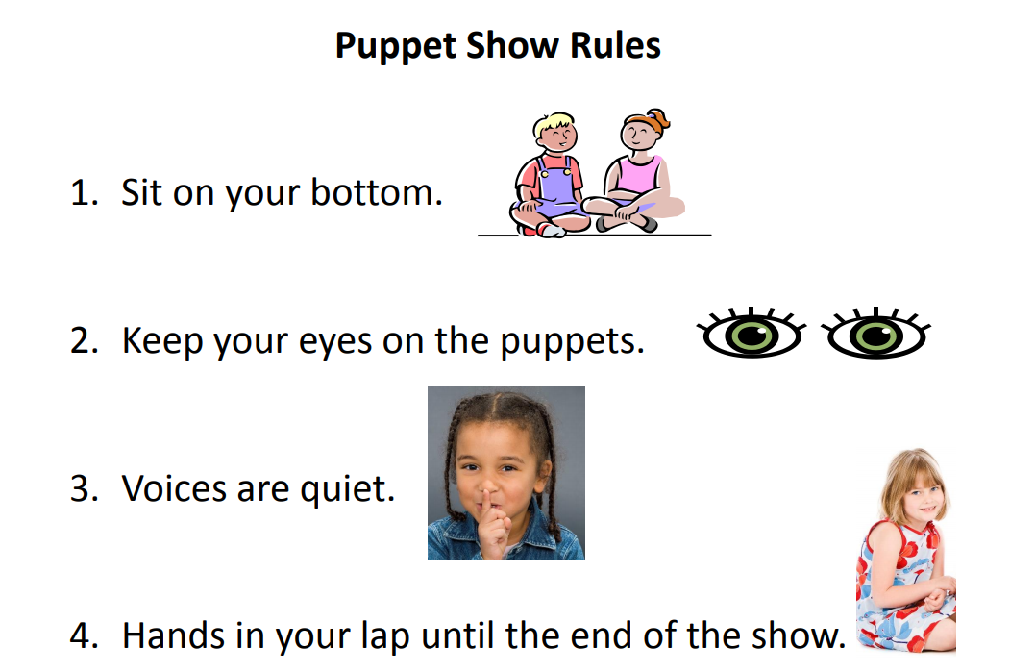
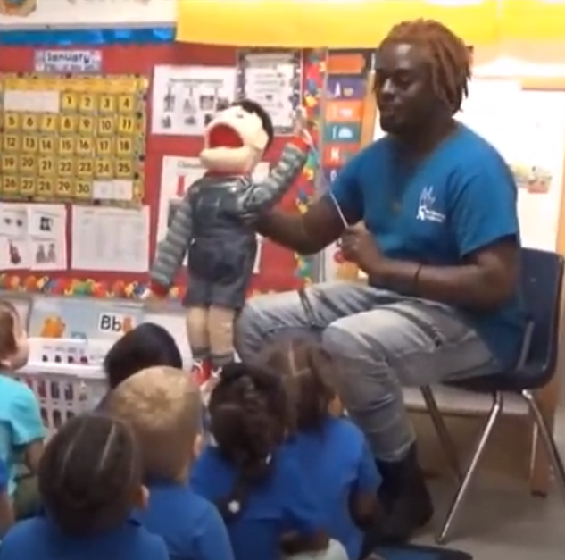

TPOT tip Tuesday
You rock, Mr. Jon!
https://www.youtube.com/watch?v=GvAP363QLvc
Pump up child engagement at circle time with puppets.

Slide 11
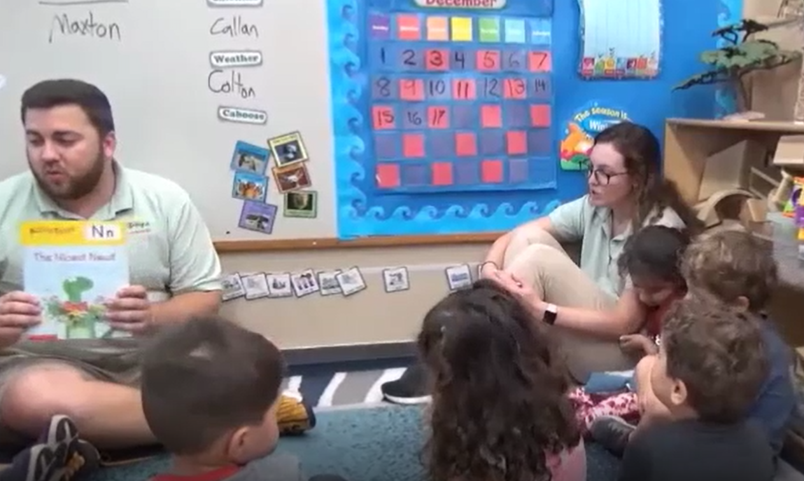
TPOT tip Tuesday
https://www.youtube.com/watch?v=Kol-nWjxHKM
NICE
It’s to be a good friend!

Slide 12

TPOT tip Tuesday
https://www.youtube.com/watch?v=JXtlTvKS9JU
TIME
It’s for a timer!

Slide 13
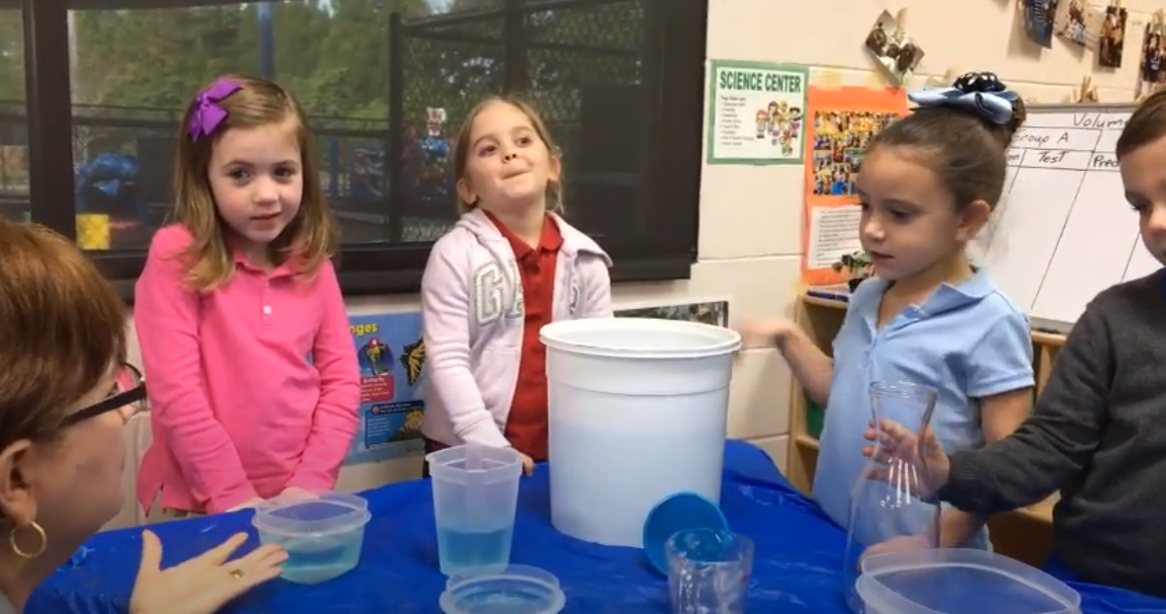
TPOT tip Tuesday
Social-Emotional SCIENCE
https://www.youtube.com/watch?v=0jIHWE0Ng4Y

Slide 14
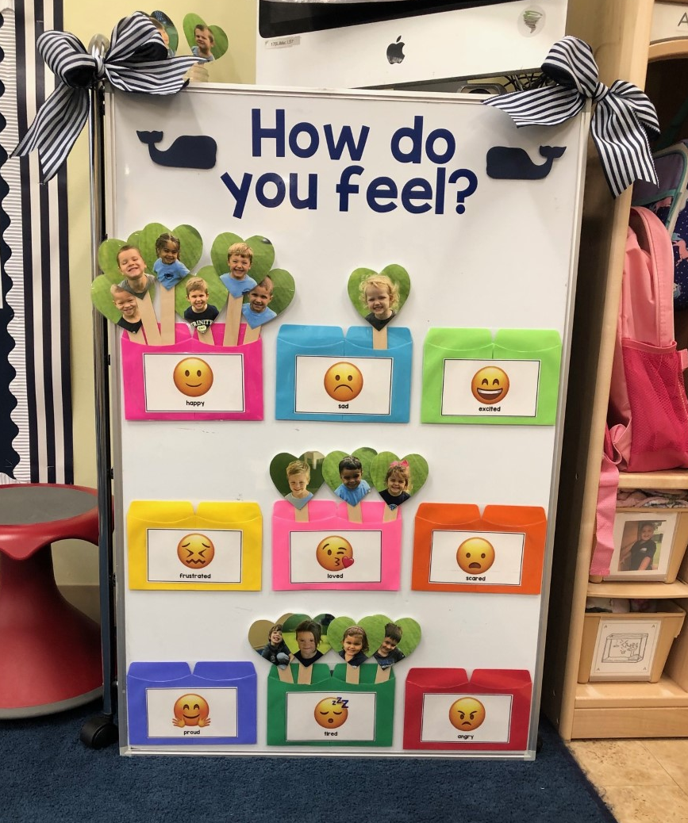


TPOT Tip Tuesday
https://www.youtube.com/watch?v=wuNsIwAOPIQ
Daily feeling check-ins provide teachers with a planned opportunity to talk about emotions with children.

Slide 15

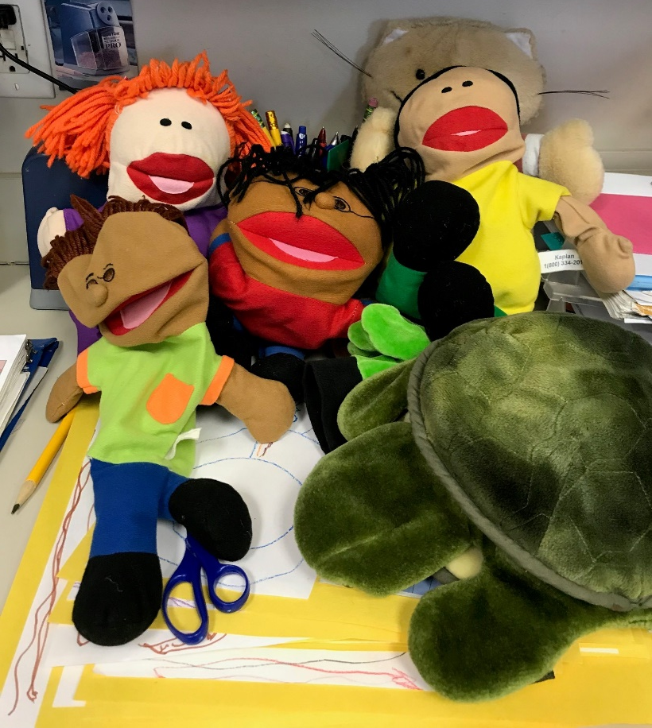
TPOT tip Tuesday
https://www.youtube.com/watch?v=xeHAhBQ46NI&list=PLaXAdXonRX0QD1Yx5NKdpt5k1Hne3bWpV&index=19
Books and puppets are great materials to use when teaching friendship skills.

Slide 16
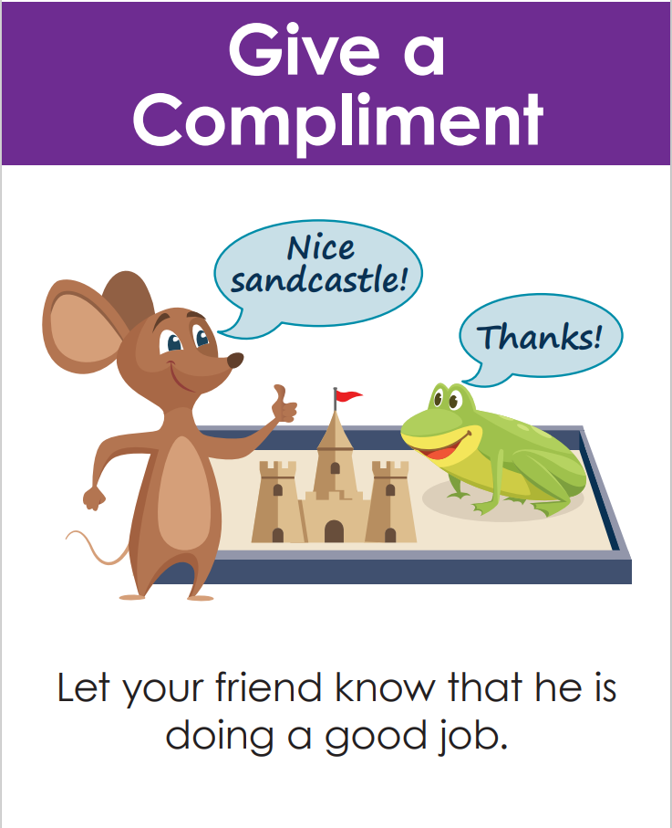
TPOT tip Tuesday
Watch how Ms. Ansley helps children practice giving compliments.
https://www.youtube.com/watch?v=ne91jI6Yvl8

Slide 17

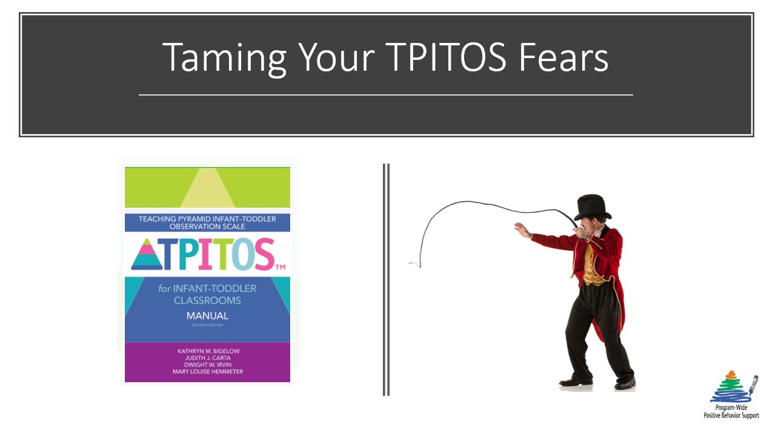
TPOT & TPITOS tip Tuesday
Introducing a scripted story for teachers
that will ease their fears of the TPOT or TPITOS.

Slide 18
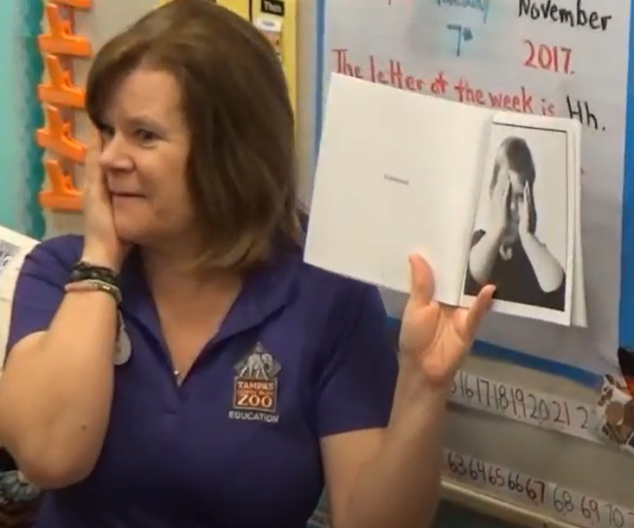

TPOT tip Tuesday
Using children’s literature to point out and discuss feelings is an awesome strategy
to promote emotional literacy.
https://www.youtube.com/watch?v=VTkZ3gRFZWw&list=PLaXAdXonRX0SgcEJZVU55xF0I5Rvjo5tK&index=59

Slide 19
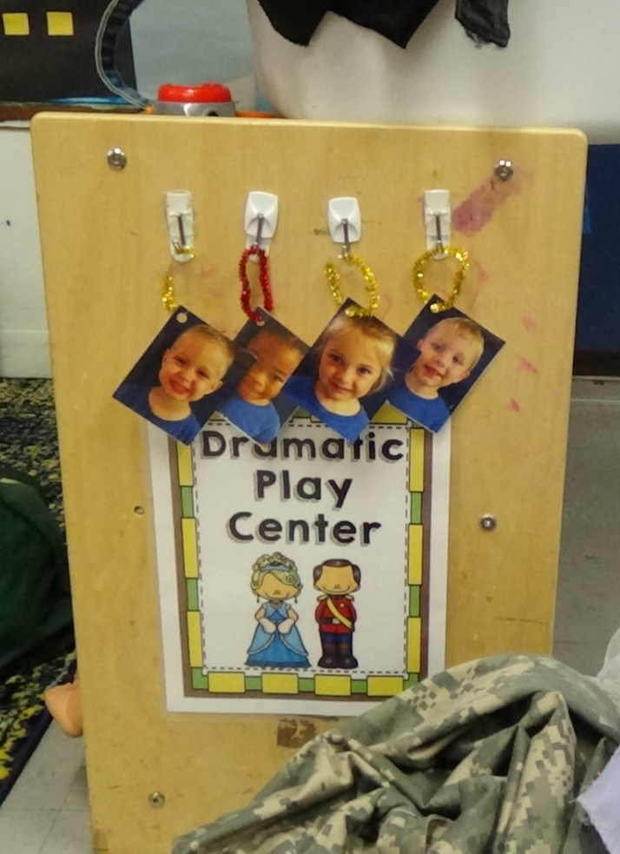
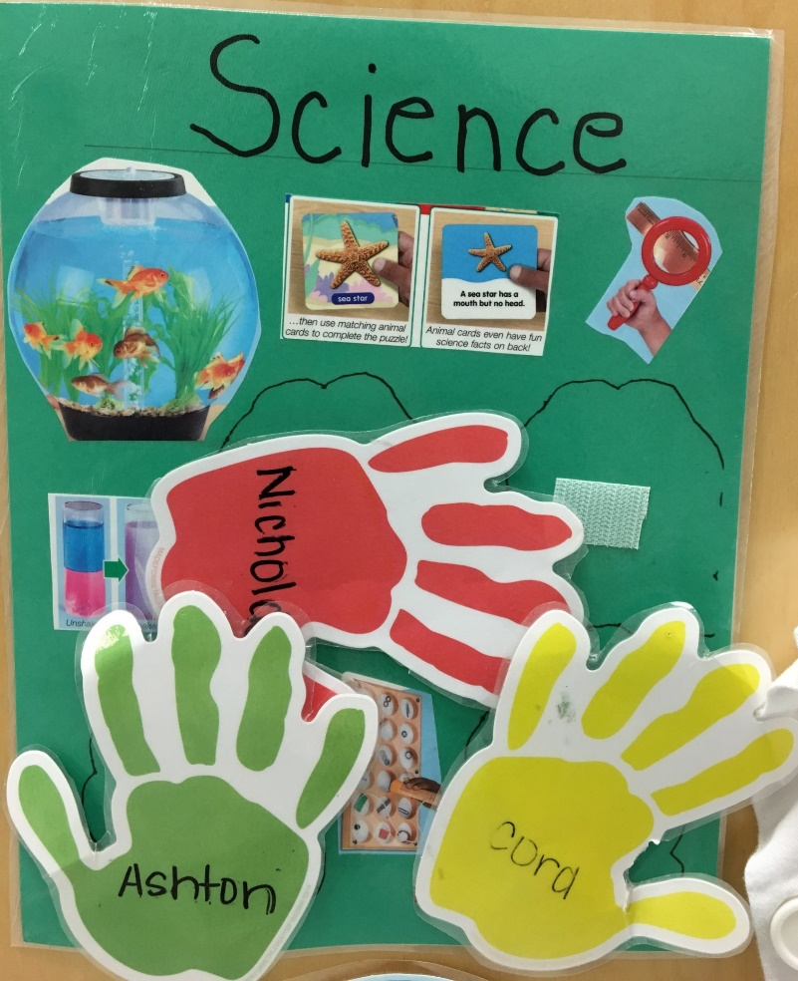
TPOT tip Tuesday
Using center tags allows children to be actively engaged in selecting an area of choice.
https://www.youtube.com/watch?v=eilGRQhF3HQ

Slide 20
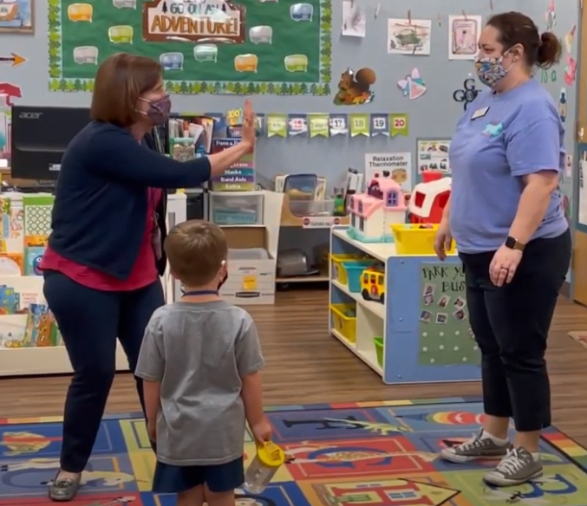


TPOT tip Tuesday
Role play is an awesome strategy to use to teach children friendship skills.
https://www.youtube.com/watch?v=gIiPHxVwUHc

Slide 21
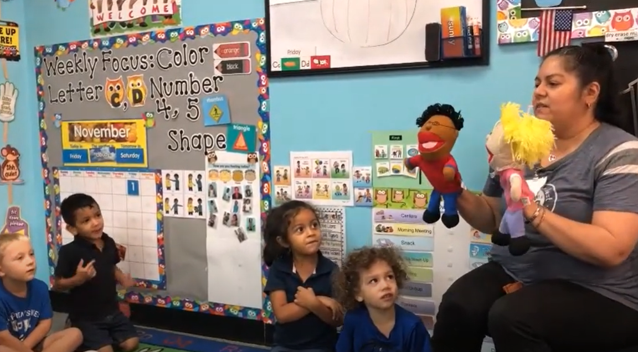
TPOT tip Tuesday
Using puppets to role play a common scenario is an engaging way to practice problem solving.
https://www.youtube.com/watch?v=cdZwPAXIZO8

Slide 22

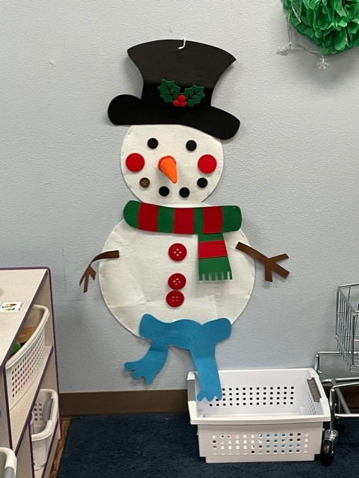
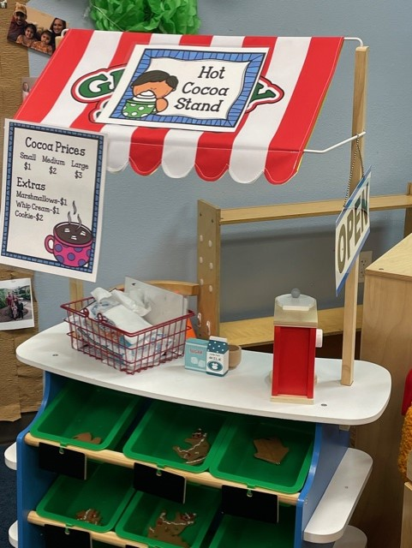
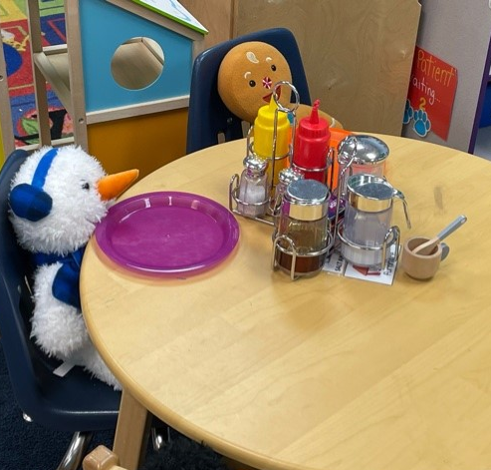

TPOT TIP TUESDAY
Check out how a Pre-K4 teacher provides center materials that correspond with the current theme.

Slide 23
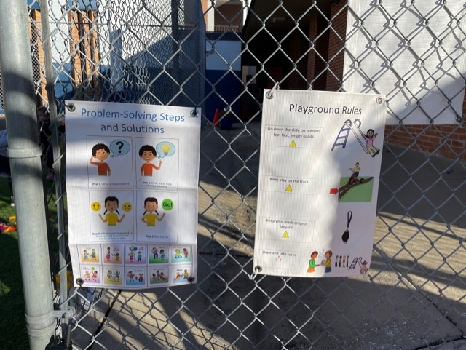
Tpot tip Tuesday
Providing children with a review of the problem-solving steps before playing outside is a great way to encourage finding solutions before they occur.
https://www.youtube.com/watch?v=ppyPNIsgbHo

Slide 24



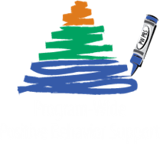
TPOT Tip Tuesday
Should I Share My Ice Cream? by Mo Willems is a fantastic book to read when teaching about friendship skills.
https://www.youtube.com/watch?v=n4wmF7ObSkk&list=PLaXAdXonRX0QD1Yx5NKdpt5k1Hne3bWpV&index=26

Slide 25
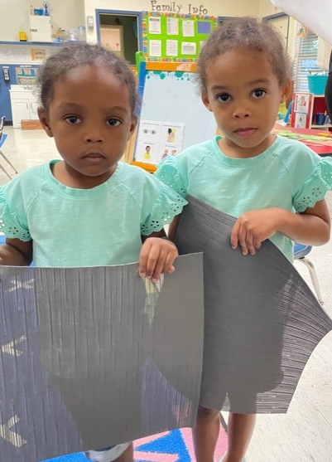
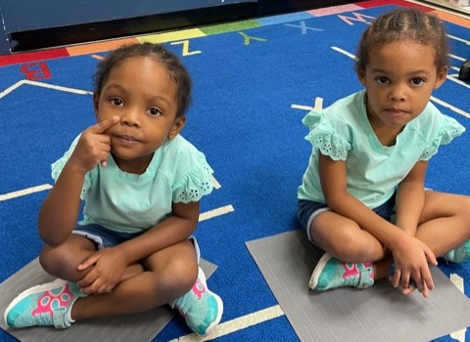
TpOT tip Tuesday
What a great idea to use placemats from the Dollar Store for individual spots at circle time!
https://www.youtube.com/watch?v=Dj1pWqMHpRs

